Slide 1
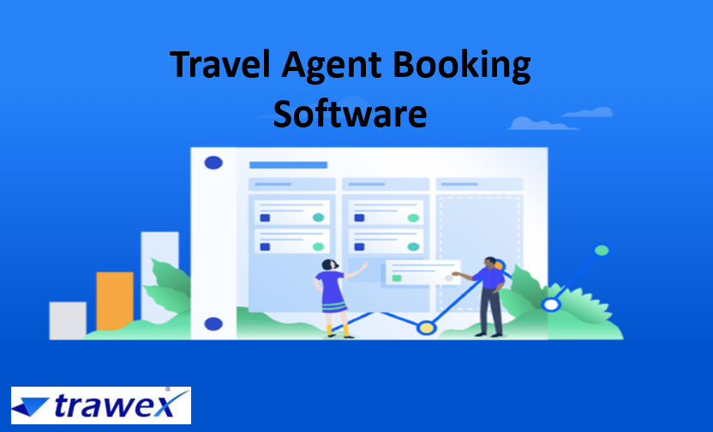
Travel Agent Booking Software
Email id : contact@trawex.com
Phone No : 91485 87111

Slide 2
What Is Travel Agent Software?
Travel agencies wanting to increase sales, minimize expenses and boost their customer service choose Trawex's comprehensive travel agent software.
Trawex allows travel agencies to manage contracts, both negotiated and direct connectivity to GDS and various supplier systems. Travel Agencies can sell through the web, social media, call centre and mobile devices.
The complete end-to-end booking system enables travel agencies to assist clients faster by automating major back-office tasks and operations including accounting, booking and CRM through a central reservation system.

Slide 3
Travel Agent Software features:
Sell through multiple channels - B2C, B2B, Call Center, XML/Web Service, Mobile and Social Networks
Assign different pricing contracts such as per-room, per person, occupancy-based pricing, range-based pricing and unit-based pricing
Add and manage markups
Connect in real time with GDS and other 3rd party supplier systems and wholesalers

Slide 4
Making your travel business reachable online is a key step in giving your business that captivating edge. Today it is no more an option.
With the influence of the internet, most successful holiday and vacation businesses function online. This not only reaches out to a greater segment of people but also enables greater visibility of services. Web-enabling your business will show immediate returns on investment.
Web booking tools not only make it easier for travelers to make tour reservations but the increased visibility and ease of transaction greatly increases the value of the business.
Showcase all your tours to prospective customers. Your travel agent software will start functioning 24/7 and it will enable these travelers to do their homework at their own pace.

Slide 5
They can search for tours after the children go to bed or at work using the boss' high-speed Internet access.
Integrating our travel agency online can facilitate obtaining more bookings, through to saving time by automating your operations.
Everything that we provide is thus you can higher specialize in the items that matter most to you. Customize your reports and see the data that's necessary for you.
Adding our online travel agent system suggests that you can cut down on tedious admin work while still having the ability to stay your finger on the heartbeat of your business. We constantly operate to stay the travel agency online at the highest of the online reservation system game.

Slide 6
This not only ensures that managing your business is created seamless and straightforward, but it also permits you to offer much better expertise to those that touch your customers. Run your business while you're ‘on the go’ using our easy app and have peace of mind that you simply will access your manifests and bookings from anyplace.
Choosing Trawex implies that you’ve picked the Best Travel Agent System on the travel market. Our travel agent system which can be used by any business taking bookings for days, nights, hours or minutes, or regular events.
If you're direct to giving up on finding travel agent online which will work precisely as you need, you have finally found the proper scheduling system.

Slide 7
Travel Agent Software for Travel Agents and Tour Operators
Our Travel Agent Online will merge with all well-liked website designers, countless cloud-based apps like Google Calendar & Analytics, list managers, CRM and accounting systems.
Our travel agent system has been designed to assist create your life as a tour operator easier. As your business grows, you might notice that you have less and less time to do what you love obtaining out there to run tours and interacting with your customers.
Trawex presents a list of some of the best Travel Agent Management Software with a detailed outline of features and client reviews.

Slide 8
With a boost of handy utility tools, agents and operators tend to use travel software and apps, that can manage bookings, travel itineraries, payments, and much more. But it would be tedious for businesses to search, analyze, and select the best solution in the market.
Thus, Trawex aids you in your search efforts while researching and listing top travel agent software from around the world.
Online travel agent software is a recent trend and many service providers are entering this space, however, catering to just one industry makes it a costlier affair and this software is priced high and may not be affordable for small service providers.
Travel Agent Software automates the front and back-office activities of travel agencies, vacation packages, destination marketers and transit companies.

Slide 9
These applications assist in generating price quotes, developing itineraries and managing reservations for tour customers as well as provide easy integration into third party reservation systems.
Travel Agent Solutions assist agencies in automating their business processes, such as accounting, invoicing, marketing and business reporting.
Travel Agent Software is related to reservations software and Tour Operator software is the best travel portal development company in India. Trawex as the best travel product fills the thrust of travel clients with the best-designed architecture.
Trawex provides travel agent software designed for the online travel and booking industry. The solution is appropriate for owners of hotels, vacation rentals, travel agencies, tour operations, rental cars.

Slide 10
Travel agents can make use of travel software to create attractive itineraries that will have spectacular photos of destinations, positive reviews from customers, ratings of products and services, special deals and offers and everything that can possibly attract a customer.
When more and more customers are attracted to such itineraries, there are higher probabilities of generating more revenue for the business.
Travel Agent Software comes with multiple benefits to the user. It streamlines the administration of the business and helps to generate higher revenue.
Our Travel Agent Software is designed to facilitate online reservations and bookings for clients as well as staff and agents. It goes without saying that such a very important method needs reliability and efficiency that a decent Travel Agent Online can give.

Slide 11
Our Tour Operator Software is a program that enables the user to manage crucial tour activities online such as reservations, appointments, bookings and meetings online. Some tour operator software also allows the clients to manage their bookings online and even make their payments.
The first advantage of using a booking and reservation platform is the accuracy and convenience for clients when availing of your booking services online which can be exhausted in real-time.
Customers are afforded updated booking information, a secure payment mechanism, and a number of alternative options to change and expedite booking tasks and processes.
You can be overcome by the sheer range of travel agency online programs presently accessible, all of which are claimed by their vendors because of the best ones.

Slide 12
But what’s best for your business is something only you can be able to verify. It's wise that when you exit trying to find a Travel Agent Online you are knowledgeable of what would work for you based on your specific needs.
The first logical issue you can be able to knock off your exploration of the Travel Agent Marketing landscape is to undertake out a number of popular platforms.
You can do this through the free trial plans or demo commonly offered by Trawex Travel Agent System suppliers, providing you with the possibility to check and do a comparison of the claimed options and capabilities.
Your first-hand assessment can be complemented by reading the findings of specialists who have subjected the product to an in-depth review and scored them based on business standards and user delight, rather like we do here on our website. By considering tools that garner high review ratings, you further narrow down your choices.

Slide 13
CONTACT US: For more details, please visit our website:
https://www.trawex.com/travel-agent-software-system.php
Email id : contact@trawex.com
Phone No : 91485 87111

