Slide 1

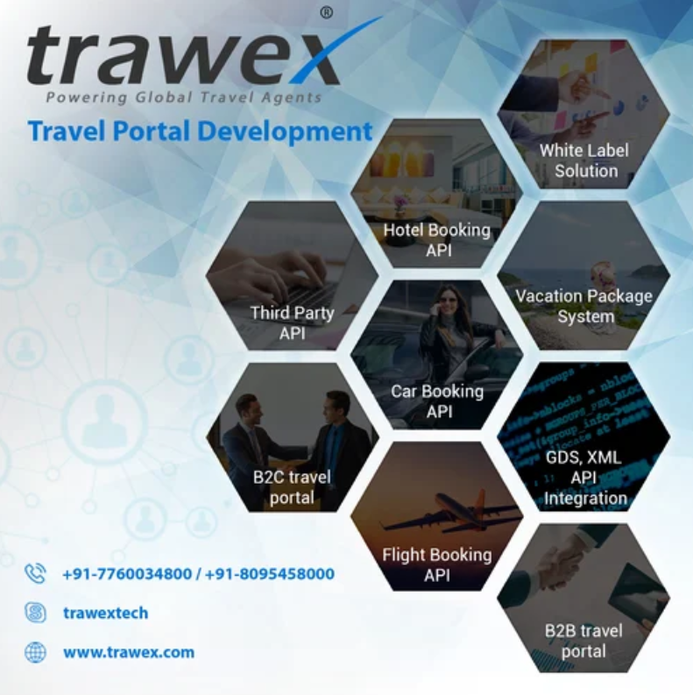
Travel Portal Development Company
Email id : contact@trawex.com

Slide 2
End To End Travel Portal Development for A Transparent and Secure Booking Process
Trawex is considered as one of the finest travel portal development company in India because the range and quality of services we offer cannot be found anywhere else.
It is always essential to understand the business needs and goals of an organization before developing a web portal for the same and hence, our web portal developers study the project effectively, so that they can offer maximum advantages to the clients by applying all the logical and exceptional elements to it.
We offer a wide range of portal development services with the latest technology that assures the best quality in design, development, testing and deployment of the web portal.
We deliver innovative turnkey portal solutions for our clients professionally, latest techniques and on budget.

Slide 3
Our Travel portal development cost is also affordable without compromising the quality of service.
Trawex has a team of travel portal experts, who through their programming and industry experience can create a complete travel portal that will address the complete needs of the travel business, including tourism operators, travel agencies, travel advisors, resorts, local accommodation providers, ticketing agencies and customers. The portal will be feature-rich and user-friendly.
Trawex is a leading Travel Portal Development Company & Travel Technology Company having clients across the world.
We specialized in portal design, development, and integration of various GDS's XML, APIs & deployment to client host after which we also maintain the product for 24/7 technical and customer support services.

Slide 4
We helping to who are looking for online travel portal development services and B2B2C Online Travel Portal Start-up Companies. We offer mobile-friendly travel portal solutions that have the advantage of providing an online experience to meet the requirements of customers and regular travelers who are always looking for competitive prices.
We integrate Amadeus GDS, Sabre GDS, Galileo GDS, Travelport UAPI, Abacus, Worldspan, Mystify, Carbolize, Trav fusion for Flights API Integration for hotels.
Our end to end travel management technology solution enables you to offer unbeatable travel related services to your potential clients.
We offer you an unproblematic base in the form of faultless travel related services which you can use to develop a strong customer segment for yourself.
Trawex is a leading travel technology company providing Online Travel portal Solutions & travel portal development.

Slide 5
We convey online travel booking portals for Flights, Hotels, Cars, Holiday packages etc in B2C, B2B mode.
We have a vast experience in the travel and tourism industry province, we develop clear insight into your requirement to develop online travel portal solutions according to your requirements. We are leading travel technology which provides services of B2B travel portal development.
We are leading B2C Travel Portal Solutions through the abilities and knowledge of their experienced management, project engineers and the team of developers in online ticket booking portal, payment gateway integration, B2C Travel Portal, content management software-based travel software.
Our aim is to provide end-to-end travel portal solutions with differentiating value-added features, this will covenant to give you the key to your success in the travel and tourism business. We offer a wide range of custom B2C Travel Booking Engine Solutions and software development services.

Slide 6
We are fully certified to work with an ability to carry out complex B2C Travel portal.
We offer the best white label solution to assist the travel companies and travel agents. We integrate Flight APIs including Galileo GDS, Amadeus, Charter Flight, Mystify, and so on.
We provide travel portal development that empower offline travel agencies, agents and companies to deliver a fully loaded online travel booking website that goes well beyond their expectation and enables them to get online.
We allow your business recognized among larger audiences. We design travel portal solutions where you can enjoy quick and easy online implementation and enhance your travel business.
We also provide Hotel Contracting System where you can also have own contracted hotels and display them on various online booking engines.

Slide 7
Want A Customized Solution for Your Travel Portal?
Trawex travel portal development company is highly specialized in delivering the best web design and development services along with the best XML API Integration services to their customers.
We enable active designs meeting high standards along with affordability constraints. Making design responsive is the crucial step.
This is what actually appeals to the visitor's complete booking in less time. Effective travel portal development allows details such as maps, latest news, tour suggestion, tour operator and medium update etc.
This ensures a better customer experience. Website integration for improved booking experience.
Better experience will result in increased bookings. We design enthralling and attractive designs for the travel sector.

Slide 8
The way a website appears to influence the conversion rate of visitors. Providing a user-oriented platform backed with advanced technology makes your business thrive.
Specialized visuals of travel are what bring the result. We involve Third party API integration such as travel service providers and secure gateway integration.
Booking an enthralling tour is the foremost concern of travelers. Seamless travel requires timely and correct information to the travelers.
Without good connectivity with suppliers, it may not be possible for tourism agencies. Travel Portal Development involves integration with different service providers which allow reasonable price to end-customers.

Slide 9
Our Travel portal development company platform:
Flight ticket booking
Create a travel portal linked to the GDS flight reservation system through API. It allows the users to obtain the online inventory on air tickets from the backend. Consequently, it redirects them to the payment gateway.
Hotel booking
It allows you to search for the different hotels from the CRS and API of Hotel and find out the most economical tariffs available for hotels.
Car booking
It will end your search for cars by providing you with the best possible option available in a particular city, as per the search of the users. Finally, it redirects the users to the payment gateway.

Slide 10
Holiday packages
Design various CMS driven international and domestic holiday packages as per the requirements of the users. Also, these are connected via online form inquiry and payment gateway in proposed travel portal development solutions.
Payment gateway integration
This integrates with the travel portal to make online payments by the customers. You can easily do it through credit cards or multiple payment gateway systems to make it globally accepted.
Our Dynamic holiday package booking solution as per the requirement of our clients. Customized CMS based holiday package booking Engine Solution with payment gateway and white Label API Integration systems for travel agents, tour operators, and travel management companies.

Slide 11
As a leading Travel technology company and especially in-flight booking system development, we understand the requirement of our clients and develop the bespoke solution as per their exact requirements. We provide airlines GDS / White label API integration services to global travel companies.
We develop a full-scale online hotel reservation system to run your hotel business smoothly. We can develop a bespoke hotel booking system best matches your requirement with hotel GDS / white label API integration service.
Grow your car rental business with our bespoke car rental booking system. Add & manage cars, instant invoicing system, manage prices, optional extras, online payment facility, manage cities and locations and many more for car rental companies to run their car rental business online.
Our experience in the travel industry and process know-how has allowed us to ensure you that we are much capable of providing you very effective and varieties of GDS.

Slide 12
Why Trawex for travel portal design and development?
Responsive & SEO friendly
Bespoke travel website design
Dynamic holiday packaging engines
Flexible language & currency options
Secure online booking
The ability to expand your products and/or services
Easy inventory management
Extendable & scalable system
Low running cost

Slide 13
We provide feature-rich travel portal design and development services for mid to large-size travel portal solution providers exceeding their expectations to maximum.
We take a deep thought, analyse your requirements first so as to get you a full feature-laced customized travel portal solution. Our website design and development professionals with their extensive know-how in travel portal development, by implementing cutting-edge technologies as well as market trends offer you the web solutions you’re looking for.
We deliver measurable outcomes and enable your escalating travel business to yield greater returns on investment. As existence a known travel portal development company in India, we provide robust solutions in this arena.

Slide 14
Our solutions related to the travel portal constitute the following important features quite helpful for your customers:
Hotel booking for domestic & international hotels
Air ticket booking for domestic and international airlines
Charter plane booking and complete travel and destination holiday packages
Car Booking engine that can facilitate a user to book the car rental of their choice at the desired location
Holiday packages to help clients to choose the preferred or suiting package as per their requirement
Trawex offers a range of online booking services in Travel domains including Flights, Hotels, Sightseeing, Transfers, car-rentals etc to Travel Agency / Travel Management Companies to augment their B2B and B2C business by offering Online Booking Capabilities to their Sub Agents / Corporate / Direct Customers.

Slide 15
We make remarkable designs for portals which will enhance your company brand which means your travel portal website will look good and attractive on almost all devices and you will see a significant increase in your profits.
We do secure portal development and provide a choice of multiple platforms as per your requirements which means you always get the best portal solutions with a high level of security and accuracy.
We do all kinds of 3rd party API integration so that your portal website can function as a hub of your operations which means you will be able to manage everything right from a central admin panel of your portal.
Our 360 degree’s-recruitment solution takes care of everything right from design to customer satisfaction which reduces your worries about technical aspects of portals and helps you to focus on your bottom line.

Slide 16
We are a leading web development organization in India. We provide travel website development services that help organizations to convey a completely stacked online travel booking site.
Our proficient group of web designers gives travel portal solutions and programming which are perfect for the developing needs of traveling companies, travel agencies, travel operators, travel advisors, and resorts. Regardless of whether you are a start-up, average size or an expansive size travel organization, we offer you the best and cost-effective solutions.
We also provide our clients with a robust packaging system that requires the packaging of multiple travel products in real-time (Air+ Hotel, Air+ Hotel+ Car, etc).
This type of packaging helps your users build and book their perfect vacation actively by mixing and matching their requirements according to their needs and budget. Accordingly, every client who visits your site gets precisely what they are searching for on one screen.

Slide 17
One of the most robust tools to make an impact on the travel industry is through travel portals. Today traveling is no longer limited to summer vacations and pilgrimages. With the growth of internet usage, having a travel portal solution of your own is sure to benefit your company and help you create lasting goodwill.
Our highly professional team of web developers offers travel portal solutions and software which are ideal for the growing needs of travel companies, travel agencies, travel operators, travel advisors, and resorts. Whether you are a start-up, a mid-size or a large-size travel company, we provide you the best and cost-effective solutions.
Being experts, we know that each business has its own sets of needs and marketing scheme. And so, we come up with a unique solution which is an integration of your requirements and our expertise.
Our web developers are with their knowledge of the latest technologies and market trends have always convey high quality customized travel portal solutions.

Slide 18
We are expert in developing Flight Booking System as well as Car Rental System, and thus help you stay at the forefront.
Along with this, we provide additional features like Payment Gateways, SMS Gateways, Online Travel Portals, Social Media Integration, Customer Review & Feedback system, Print & Email Confirmation vouchers and Online Chat.
We also provide our customers with a robust packaging system that involves the packaging of multiple travel products in real-time (Air+ Hotel, Air+ Hotel+ Car, etc).
This type of packaging helps your users build and book their perfect vacation actively by mixing and matching their requirements according to their requirements and budget. Thus, every client who visits your website gets exactly what they are looking for on one screen.
Tour & travel have always been desired whether for business or for enjoyment. Through our Travel API, the travel agents can use our web application to fulfil the travel related needs of their customers.

Slide 19
By integrating this travel API with your own software solution, you as a travel service provider can offer unbeatable travel related services to your future clients.
Our travel API enables you to perform many activities obtaining travel consultation, searching for trip plans, seat layout, offering customized tour packages, booking tickets (airways, railways, and roadways), cancelling tickets, generating reports for booking and cancellation, etc.
Our end to end travel management technology solution allows you to provide unbeatable travel related services to your potential clients. We offer you an unproblematic base in the form of perfect travel related services that you can use to develop a strong client segment for yourself.
Trawex Developments offers its travel-related services through a B2B network. We provide customized and stress-free backend services for ticket booking (air ticket), hotel booking, searching for preferred destinations and other tour

Slide 20
We are in the process of introducing our tour & travel related services through a B2C network also in the near future. Through our B2C portal, the final customers would be able to plan and fulfil their tour and travel-related requirements.
White Label Global Software Developments provides fair and suited white label services that help you build your brand and enhance goodwill. You need not develop the entire travel solutions from scratch rather you can use our service base for extending unproblematic services to your clients.
Trawex is a global travel technology company delivering online enterprise travel portal solutions, online portals, software’s to travel community. Our 'Travel portal development' have Comprehensive experience of the travel domain and software’s to turn-out the most preferred travel technology applications, Remarkably.
Our technology team has vast experience in the travel domain, understanding travel business rules and interested to implement ideas and the latest trends in travel technology.

Slide 21
Technology architects have experience of providing state of the art system for leading travel agencies across the world.
We believe in teamwork; we share innovative ideas and we love finding the existence method applying to our products that make our customer trust on fore technology robust every day.
Trawex Travel portal development services improve and shape the travel companies and their websites. So that they can attract actual traffic and earn a lot of profit.
We have several ranges of travel portal solutions and software’s that help in developing all the tourism-related companies, resorts, agencies, advisors, tour operators etc. We are capable of meeting your requirements and hence you will succeed in your business.
Earlier there was no competition in this field but now you can see there are many companies that deal with tours and travels. So, it has become mandatory now to be active with these company.

Slide 22
We can grow the travel portals according to the search engines. So that after implementing online marketing techniques you can get good ranks and increase your revenue.
Trawex is a leading travel technology expert with a focus on providing world-class services to the travel industry. Our technology helps travel agents automate their business process, boost revenue stream and enrich their customer service experience.
We understand the requirements of the travel market and we work accordingly to provide best in class solution with the shortest time to market. Our Expert team has a ruthless focus on providing a scalable and reliable technology platform which can be the growth engine for ambitious travel companies.
We are dedicated to providing a smart solution that has a high grade of compliance with diverse business processes within the travel domain. We help medium and large size travel companies get the best out of their travel supply business every day.

Slide 23
We empower Travel intermediaries, travel management companies, suppliers, distributors, travel agencies, and tour operators to avail the benefits such as: -
Automate Their Operations to Scale Up
Automation in consolidation, distribution, and sales
Better control of prices, products, and staff
Providing access to the right content, right availability at the right price
Advance reports and analytics
Travel Portal development is a software that meets all the traveling and booking related concerns in the best possible way. This software allows you to help of the services without any involvement of the travel booking agents that will charge you an impressive amount and shatter your budget.

Slide 24
There are multiple features of this portal for increasing the customer’s experience and retaining them. The most important features of this portal are as follows –
Booking of rooms and following in hotels (both international and domestic).
Air ticket booking for airlines (both international and domestic).
Car booking for visiting nearby places.
Charter planes for availing the exclusive travel and tourism packages. Tourists can avail of these packages as per their requirements.
Foreign money exchange for people to purchase and for you to sell in their currency.
The payments can be done via debit cards or credit cards and other payment methods.
At the time when booking is done, the customer will get the notification of booking on his/her mobile.
Even the travel agents can create their accounts to book from their officers.

Slide 25
Trawex leverage cutting-edge technology and programming skills to deliver top-notch software. The portal we have will not only handle your requirements for holiday vacation, flight booking, hotel booking, car booking, and extra features.
With one of the best factors to determine and improve the Indian economy, the field of tourism is one of the biggest contributors. It is still growing at a fast rate and is expected to rise for decades.
The travel portal development of our Solutions provides some benefits that assist in making every step easy, reliable, and granting a seamless and enjoyable booking experience. This portal is compatible with all the operating systems to simplify the client experience.
The software/ application is specially designed for travel management companies, destination management companies, travel aggregators, B2B B2C travel agencies, tour operators and home-based travel agents.

Slide 26
Our Travel Portal Development Services include:
Travel portal Development
Travel website Development
Modern Travel portal
Travel portal design
Re-develop your existing Travel portal
Tourism portal Development
Travel web application
Travel booking system
Travel portal maintenance
End-to-end Travel portal solutions
Custom Travel portal Development

Slide 27
Contact Us For more details, Pls visit our website:
https://www.trawex.com/travel-portal-development-company.php
Email id : contact@trawex.com

