Slide 1

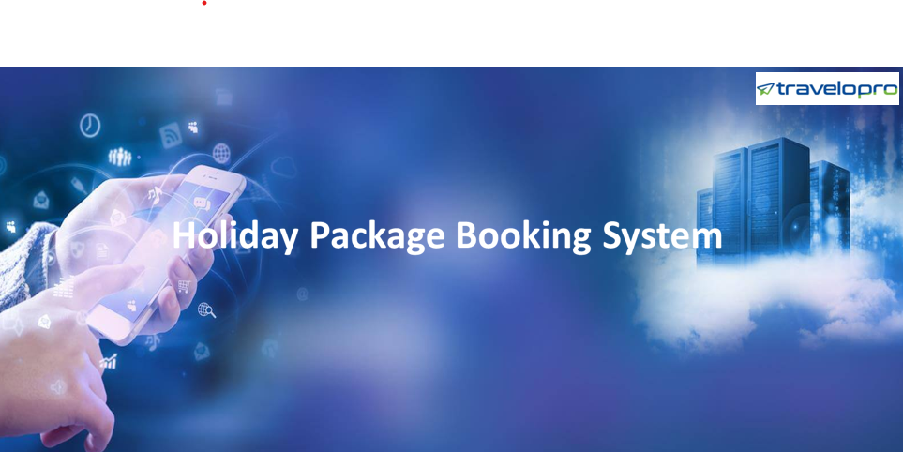
Holiday Package Booking System
Email id : contact@travelopro.com
Phone No : 98455 66441

Slide 2
What is Holiday Package Booking System?
The Holiday Package Booking System Development is an online travel solution module where a tour operator accesses all of the package's details, such as itinerary, inclusions, exclusions, and so on, in the Add Package section.
An administrator or tour operator can add complete package details like day-wise itinerary, sightseeing, transfers, accommodation, etc. for a specific package and can easily edit or modify all ancillary package requirement details.
All of the details will be displayed in the website's B2C panel, and customers will be able to easily view the package and check the products included in the package. Travelers can customize and design their tour-related services based on their preferences.

Slide 3
They can choose their accommodations based on their needs, sightseeing, convenience, and so on. Create a personalized tour booking from the available options, and a price quote will be generated.
Travelers can make an online booking by processing the necessary details and make online payments through the online multiple payment options. Users can download the tour package itinerary PDF for their reference.
The traveler’s package booking request will be displayed in the admin panel so that the administrator can assign this to his/her staff. Staff will contact the customer and manage things consequently.

Slide 4
How To Develop Holiday Package Booking System That Attracts More Tourists?
Running a tourism business? or If you have a Tour & Travel website and looking for the best holiday package booking system or holiday booking website redesigning, connect with Travelopro.
Travelopro is among the travel portal development company, offering complete Travel & Tour booking software for the tourism industry, with high-end features of tour and vacation package modules.
We have decades of experience in Travel Technology Solutions, and we can help you with B2B, B2C, and B2B2C travel portal designs, development, and marketing via SEO/SMO services.
Our travel portal includes GDS/third-party API integration for b2b flight booking portal, hotel booking, and car booking services. We provide a wide range of travel portal solutions for B2B and B2C travel agencies all over the world.

Slide 5
The portal helps travel agents, tour operators, and web portal consolidators sell, manage, and collaborate with their B2C clients as well as their B2B partners and suppliers. It is a completely web-based system.
We developed a smart vacation package system wherein customers can search for packages designed from an admin panel by travel companies and have all relevant information such as inclusions, itinerary, prices date wise, and accommodation details so that clients or users can check all relevant information from a single place and book the package without consuming their time by traveling physically to a location.
Outsource your travel portal development and holiday packaging system development, vacation package system, and tour package portal development to us to get the travel software solutions at a reasonable cost.

Slide 6
Travelopro offers advanced vacation packaging software for tour operators that will assist you in creating a package, managing inventory, group travel, managing customers and travel agents, fully automating your sales process, improving your service ordering, managing accounts, and gaining full insights into your travel business.
For global travel companies, we develop Vacation Package System, Travel Management Software, Online Travel Agency Software, Travel Agent Software, Online Travel Booking, Online Ticket Reservation, Online Reservation System, Ticket Booking Online, Travel Booking, and Travel Portal Development.

Slide 7
We develop a bespoke holiday package booking system that allows travelers to make easier reservations, modifications, and cancellations directly from the website. We provide Tour Operators with realistic and cost-effective booking engines.
Our advance tour booking software for tour agencies enables you to manage all aspects of your travel business from a single platform. Create vacation packages, book hotels, manage customers, make transactions, and grow your sales by improving your tour business with our worldwide vacation packages API and online tour booking engine software.
With our holiday package booking system, you can convert your website traffic into confirmed, commission-free bookings! We develop booking engines using cutting-edge technology and tools, allowing travel agents and tour operators to maximize their profits.

Slide 8
Why Travelopro Holiday Package Booking System?
Travelopro offers the best Holiday Package Booking System, Package Booking Software, and advanced Package Booking Quotation that comes with a perfect Package Booking IT Solution that helps travel agents or tour operators to multiple functionalities such as creating a package, managing inventory, group travel, automating sales, ordering, accounts, managing customers, and managing travel agents into their travel business.
Also, Package Booking Professionals experts develop a customized Holiday Package Booking System which comes with additional features like reservations, modifications, cancellations, and package quotation. This Package Booking Software is also reliable and cost-effective.

Slide 9
Travelopro assists travel companies to outline their vacation packages and sell online through B2C and B2B portals. Our backend system includes a comprehensive CMS (content management system) for travel agents, home-based travel agencies, and tour operators, which allows users to configure a package as well as flights, hotels, day activities, terms, policies, and so on, as well as its visibility preference on websites.
Our package booking engine provides a quick and easy reservation process that requires minimal effort to book the desired package online. Our solution works on PCs, laptops, smartphones, and tablets.
The package booking engine enables you to combine various vacation properties such as flights/hotels/cars/transfers/excursions. You can make packages for GIT or FIT in the same system and users can book as per their requirements.

Slide 10
In the holiday package booking engine, customers can book vacation packages or weekend getaways with a wide range of local attractions, tickets, and various options for Hotel Categories and different combinations on packages such as romantic, adventure, luxury, honeymoon, or family Packages.
OTAs can provide multiple options to their customers using this holiday package booking engine software, allowing them to choose from a wide range of available packages based on their needs.
Travelopro's package booking Engine is a fully customized tool that provides the client with faster, easier interfaces for reservations directly from the website.
We have a highly comprehensive booking management tool associated with the travel booking engine that allows for simple post-booking operations such as additions, modifications, and cancellations, as well as notes and special standards to enhance your customer service, with all booking history stored in a single location in the package booking engine.

Slide 11
Features of Holiday Package Booking System we offer:
Catalog definition – This feature allows you to enter all of your products such as packages, entrance tickets, rent-a-car, vessels, and cruises.
Create complex tours and packages
Completely automated supplier ordering
B2B (Partner booking)
Online booking B2C
Domestic & International Package systems
Tour Package API Integration
Dynamic package with different transfers
Easy Tour Package Bookings

Slide 12
Mobile Responsive Layout
Attractive Tour Portal Design
Auto Cancellation of Holiday Packages
Advanced Reports
User-friendly back-office interface for outlining vacation packages
Description of a package
Pricing definition as per standard, deluxe, and premium packages
Hotel description with star rating
Diverse management for vacations, hotels, flights, and transfers
Booking engines for hotels, flights, vacations, activities, and transfers

Slide 13
Integrated shopping cart and payment gateways
Live chat and feedback options for customers
Registration and membership for customers
Back office panel with automated markup, commission, refund, and cancellation policies
MIS Reports for the administrator
Accounting management and markup management
Dynamic packages based on requirements: flight + hotel, hotel + car, etc.
Advanced search available
Check inclusions & exclusions

Slide 14
Select the required package from various available options
Check all included itineraries in the package, and day-wise details for each location
Filtration of available packages, such as price range, price, and name sorting, and so on, with responsive design
Result view in grids, list & map views
Apply different markups on agents
Amendments & Cancellation of bookings
Apply discounts and offers
Auto email & SMS alerts for booking confirmation
Email vouchers & invoices for bookings
Multicurrency search & booking are available

Slide 15
Reasons to Start Your online Holiday Booking Portal Today
Manage Your Agent List and Obtain Verified Customers
Easy To Manage Bookings, Markup And Discount
Holiday Bookings Online is one of the leading online booking system providers for self-catering accommodation owners
Very high customer satisfaction with the easy-to-use reservation system
Using this online booking system can significantly increase property occupancy rates
The online booking system includes a comprehensive admin control panel that makes booking management easier and less time-consuming
Manage your online bookings from the office, home, or even when away on holiday
Daily backups of booking system data ensure your data is secure

Slide 16
How does Travel Agency benefit from Holiday Package Booking System Development Software?
Travelopro Package Booking System or Package Booking Software comes with advanced technology which is complete Package Booking IT Solution to develop the booking engine helps travel agents and tour operators to enhance their revenues.
Travelopro is a leading Travel Software Development Company that creates the best Package Booking Software for travel agencies and tour operators to manage inventory, bookings, group travel, customize packages, and automate sales to maximize bookings and revenues.
We create fully customized tour booking software that allows travelers to make reservations, changes, and cancellations directly from the website.

Slide 17
Package Booking Software has various functionalities like reservations, modifications, cancellations, and package quotations to help travel agents manage hotels, flights, tours, transfers and increases user experience.
It is easily integrated into the existing system and comes with B2B/B2C booking option, Online Calendar Availability, Advanced search available, third-party supplier integration, itinerary & quotes, dynamic package creation, package inclusions & exclusions, online payment option, and multi-currency and multi-language features to increase business efficiency and maximize online package bookings.
Our goal is to build an all-in-one package booking engine that allows the desired customization in your package holidays. Using our package booking engine software, online travel agents can offer a variety of options to their customers, allowing them to select from a wide range of deals based on their needs.

Slide 18
We have package booking tools to meet the needs of your customers. With our tour package booking software, you can provide your clients with an incredible experience that includes not only your tour packages but also a smooth booking flow.
Our Booking Engine's packaging solution enables you to create custom travel packages by combining air, hotel, and cruise bookings, as well as other travel products.
We create holiday booking engines with cutting-edge technology and tools to help travel agents and tour operators maximize their profits.
Give your guests extra revenue by enabling them to make unique deals, promotional codes, and group bookings.
Get in touch with us to know more about Holiday Package Booking Portal Development services in detail.

Slide 19
CONTACT US:
For more details, please visit our website:
https://www.travelopro.com/holiday-package-booking-system.php
Email id : contact@travelopro.com
Phone No : 98455 66441

