Slide 1

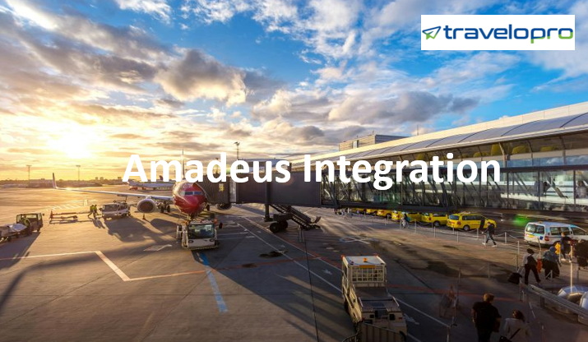
Amadeus Integration
Email id : contact@travelopro.com
Phone No : 98455 66441

Slide 2
A Quick and Easy Way to Increase Your Travel Inventory & Facilities
Amadeus is a well-known Global Distribution System (GDS). It is Central Reservation System provides real-time search, pricing, booking, ticketing, and other post-booking processing services to travel agencies and service providers all over the globe. Over 100,000 travel agencies worldwide utilize the Amadeus GDS system and software platform.
It helps the clients select and book tickets from 490 air carriers globally, including world-renowned airlines (British Airways, Delta Airlines, Lufthansa, and others) and low-cost carriers.
Amadeus has a team of professionals working in the areas of Airlines, Airports, Cruise, Tour operators, Destinations, Online Travel agencies, Business Travel agencies, Hospitality, Travel Insurance, Metasearch & Travel Media, Rail, Corporations, and Mobility.

Slide 3
The Amadeus booking system provides a complete solution, from the initial search to the fulfilment of the booking. The Amadeus airline software makes it simple to make an online reservation.
To book a flight, the consumer merely has to go through the Amadeus airline booking process. Amadeus Flights integration enables connecting to GDS Amadeus using XML API for online flight ticket reservations. Amadeus GDS supports travel agents and agencies in serving travelers and growing their global business by helping their clients to get the best deal.
The Amadeus Global Distribution System has a tremendous amount of data that OTAs may use to provide to their clients. Travel agents may access real-time inventory and pricing for airlines, among other benefits, through a single platform.

Slide 4
It can help you increase your profits and manage your investment risks. It also offers data management, sales and bookings, and revenue management. The Amadeus GDS System allows you to develop and upgrade your own bespoke travel booking applications at a low cost. It is simple to deploy and integrate with current systems, ensuring that you are always at the latest technology.
Amadeus provides a backend platform for travel businesses to search, price, book, and post-booking processes and SOAP/XML API to travel agencies, allowing them to incorporate travel-related content into their application (Web or Mobile).
With Amadeus API integration, your travel website will be able to access offers from over 300,000 hotels and 288 hotel chains in 195 countries. Amadeus GDS helps you manage your travel company by cutting costs and improving profitability.

Slide 5
Features of Amadeus Integration Services
One Way/Return/Multi-City search option
500+ Global Airlines, some exclusively on Amadeus GDS
search filters to get the most relevant information
Fare and Pricing Information
Detail Fare and Pricing Information
Add on Services/Ancillary Services available
SSR Details- Seat map & baggage
Booking Confirmation (GDS and Airline PNR)
Hold and Issue ticket
Post Booking Services - PNR status
Cancellation, Modification, and Refund process

Slide 6
How Travelopro Amadeus Integration Services Best Fit Your Requirements?
Travelopro provides Amadeus XML API Integration for many suppliers such as GDS and travels APIs. We provide comprehensive travel website solutions and travel portal software for the tours and travel sector. Choosing a worldwide leader like Amadeus and utilizing our Amadeus GDS Integration services can propel your business to new heights.
Our customer-focused advanced technology solutions maximize the demands of travel agents. We include the Amadeus GDS API into websites for hotel, airline, and car inventory, along with bespoke backend and booking services. Provide a customized search engine, affordable rates, and simple reservations to your clients.

Slide 7
We provide a comprehensive online travel booking software platform that includes user modules such as B2C, B2B, and B2B2C services modules such as flights, hotels, transfers, cruises, rails, sightseeing, and backend admin modules. Our developers have years of expertise in designing or integrating API credentials into websites. As a result, after the website is deployed, you will be able to experience smooth continuity in your business.
Amadeus GDS has always strived to deliver services that help their clients increase their abilities and customer focus. Our travel software solutions are used by traditional and online travel agencies, travel wholesalers, tour operators, online ticketing agencies, rental companies, and technology development companies.
Travelopro provides innovative travel technology solutions to travel agencies worldwide, such as ticket booking software, airline reservation systems, travel portals, and booking engines.

Slide 8
Advantages of Amadeus Software Integration
Amadeus software features include reservations, inventory management, passenger profiling, and PNR generation. After all, Amadeus is widely considered one of the world's leading global distribution systems. With our help, you can effortlessly take advantage of Amadeus' many features and benefits.
Travelopro has a proven track record of enhancing ROI, helping with client retention, and extending the consumer base. As a result, we use the Amadeus booking engine to link travel providers and customers, lowering obstacles to convenient travel.
Moreover, Amadeus software helps the entire travel industry uncover and increase profitability. It aids organizations in identifying new sources of revenue and generating revenue.

Slide 9
With Amadeus travel software, it is possible to boost the value of numerous business operations for travel suppliers and users. This GDS is among the best for all types of bookings and reservations, mainly airline tickets. As a result, Amadeus can assist your travel company in succeeding in the competitive travel sector.
Our GDS-based airline reservation system connects to several airlines and displays availability and pricing information in a single window. We also provide information to multiple distributors and travel companies working simultaneously around the globe.
Travelopro can help you use Amadeus to increase your market reach, attract new customers, and give chances for up-selling and cross-selling. As a result, Amadeus is particularly beneficial for travel agencies to remain competitive and increase profits.

Slide 10
Timesaving: Amadeus saves time by providing all travel agency data to travelers on a single screen.
Convenient to use: It is easier to find and comprehend information.
User-friendly: Amadeus is more efficient and cost-effective.
Rapidness: There are quick responsive terms.
Possibility: There is a good chance for cross-selling products and providing clients with discounted rates.
Control and profit: The entire travel agency operation is managed and can be integrated, as well as also revenue may be increased.

Slide 11
Amadeus Travel Solutions
Amadeus Flight Reservation System
Amadeus provides the best Flight XML API integration for travel agents to have rapid access to interactive flight booking solutions for effective flight booking administration. Our single API integration can provide you with inventory from multiple GDS systems, flight consolidators, and low-cost carriers (LCCs). A global distribution system can help you increase your sales all over the globe.
Book airline tickets
One-way flight search
Search for round way flights
Search for flights by city or airport

Slide 12
Amadeus Hotel Module
Amadeus has 730,000 unique properties all across the globe. On your online travel booking platform and applications, provide quick bookable pricing. Amadeus helps link individual hotels and small chains, distribute hotel inventory and make it visible in the world's leading global distribution system.
The Amadeus API is an excellent tool for marketing hotel properties and services. By connecting your hotel to the GDS system, travel agencies will have access to real-time inventory information, allowing them to sell rooms at your facility to their clients.
Search for a hotel by city, category, hotel name, dates of stay
Number of rooms and tourists
View detailed hotel descriptions
View price breakdown per day Book hotels

Slide 13
Amadeus Car Rental API Integration
Amadeus combines cutting-edge technology with unrivaled travel industry experience to find the best car and car rental deals. Agents can integrate Amadeus cars into their existing online travel booking system to get a vast range of car rental content and allow their clients to book vehicles of their choice quickly.
To keep ahead of the competition, agents can utilize the Car rental worldwide distribution system to send real-time rental car booking information. Car rental companies may reach out to a diversified client base by making their content available through a global multichannel technology solution
You will have access to a wide range of car rental services.
The system is completely integrated with the passenger reservation system (PNR) and the back office.
Provide outstanding service to your clients.

Slide 14
Best API To Sell Flights
Amadeus provides a highly efficient and interactive booking solution that helps OTAs build booking fields by distributing air and non-airline content to a wide range of distribution channels.
Access real-time and updated data about flight status and actual costs, and make bookings instantly – while also lowering your overheads. Integrating the Amadeus global distribution system with your travel site or booking engine may give massive real-time data and the ability to book flights online with a plethora of options.
Amadeus is a leading GDS that offers API services for booking flights, hotels, cars, and cruises. Users can access flight data, book flights, handle tickets, and check seat availability due to their seamless integration. With Amadeus API Integration, travel agencies, DMCs, and hotels can book flights and accommodations on their websites.

Slide 15
Why obtain Amadeus GDS API?
Scale your capability
Save time
Enable technology
Boost income
Connected with worldwide inventory

Slide 16
CONTACT US:
For more details, please visit our website:
https://www.travelopro.com/amadeus-integration.php
Email id : contact@travelopro.com
Phone No : 98455 66441

