Slide 1

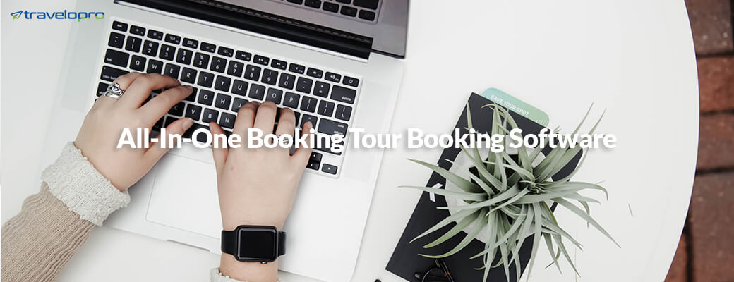
Tour Operator Management System
Email id : contact@travelopro.com
Phone No : 98455 66441

Slide 2
Tour Operator Software is travel software designed to automate online tour inventory, booking, group booking, payment gateway, package customization with best features such as Backoffice management, Accounting, MIS Reports, CRM and ordering for travel agent, tour operators, travel agency and travel portal company.
Tour and travel companies that coordinate advice tours use tour operator software to manage customer advice, tour information, and back-office activities.

Slide 3
This type of software encourages tour operators keep track of organizational condition of tours such as organize, itinerary, meals, and more. Moreover, it tracks tourists and attendance, as well as employee tasks and activities. Tour operators are adept to purchase this type of software to manage costs, expenses, and revenues.
Travelopro develops platforms & solutions to empower businesses to leverage the immense effectiveness of the Internet. We contribute a scalable cloud-platform that supported collaborator-based booking, travel operations, and customer services for multiple channels. Our tour operator software provides an accessible way to automate tasks and increase your bookings.

Slide 4
What are best features of tour operator software?
Mobile friendly
Multicurrency and Multilanguage
Payment Gateway Integration
Barcode Scan
Dynamic and Multiple Tour Option
Itinerary Creation
Package Customization
Booking Management
Customer Reviews
Track record of tickets accepted, issued and reclaimed

Slide 5
Which is the best Tour Operator?
Travelopro is best Tour Operator management system who can integrate with various travel suppliers and built best tour package, activities, hotels, transfers, car rental services and sell them directly to travel agents, travel management companies and destination management companies to increase business profitability.
In Travel Industry, many changes impact tour operator so it is profitable to find the best tour operator software which can encourage travel agents and tour operator to develop their business.

Slide 6
The First Ever Cloud Based Tour Operator Software
Travelopro is the first specially designed tour operator software that takes care of all business commitment of tour operators, travel company and entire travel industry with its absurd and 100% convenient features.
Travelopro is a complete travel ERP software for managing your tour and travel business efficiently and in a convenient manner. Arrange with utmost consistency, this Software confirm to be an end-to-end solution for all tour operators unified business-related needs. Now develop and compliment your business with this useful travel management software.

Slide 7
This online tour operator software has got the admirable opportunity for all the travel owners to entrust their business with its exclusive features. The following are the key features that are included in this software solution to address your travel business needs.
Now manage updates of real time booking status with this travel software. Our travel software grants you to manage entire travel business by automating many back office related tasks and functions with its eventual people features.

Slide 8
Travelopro Tour operator software
Travelopro is a leading travel software solutions company. We develop extensive travel software including flights, hotels, transfers, cars, sightseeing, insurance and holiday packages. The travel software is customized to meet the day to day needs of travel agents / travel agencies and end customers.
Starting from the initial search, availability feedback, selection summary, payment & PNR / voucher generation, everything can be managed online and modification can be done through backend.
Our clientele in travel and hospitality domain includes top travel agencies, tour operators, airlines, aggregators, booking portals, destination management companies, inbound agents and hoteliers. Our travel industry software assures about security, accuracy and quality of travel business.

Slide 9
A booking engine or online reservation system: A booking engine is a user interface for online bookings. This engine grant guests to enter their approved date, room type, and package option. After selecting their desire, guests endorse their reservation in real-time on the website or via a website link.
Payment processing: Payment processing assign to the capability to approach payment from guests online via credit card or PayPal. Some software providers integrate their services with payment systems related to Stripe.
Booking management: Booking management is the capability to approach a database of all reservations where you can change dates, edit names, process cancellations, etc.

Slide 10
Customer relationship management (CRM): A CRM is a database with advice for all your guests including contact information, desire, past bookings, and more. This advice encourages you to send targeted marketing offers and offer a more personalized experience to your guests.
Travel agency management: A travel agency management feature grant travel agents around the globe to comfortably book your products.
Reports: Many web-based tour operators offer customizable reports based on a plethora of metrics.
Reviews and ratings: A review/rating feature allows companies to collect guest reviews, send feedback, and display reviews on their website. The capability to hear feedback encourage to enhance business services and make potential guests more convinced about booking with you.

Slide 11
How we will help?
Travelopro is a leading Travel Technology Company which contribute Travel Technology Solutions to the Travel Business. Our Travel Technology Software will encourage you to instrument your innovative concept and vision.
We are the expert travel software company that is accomplished in API/XML Integration of GDS like Amadeus, Travelport and Sabre to provide your customers a deep range of travel products with real-time availability, details, fares, rules and policies. We enlarge the customer service search experience and provide them with an option of choosing the best from a wide variety of products.
Our travel technology solutions are developed to manage client business achievement and expansion on prior basis. With its excellent flight tracker, trip planner booking Cost tracker and more travel technology services, Travelopro has attained the power of a superior travel technology company.

Slide 12
Benefits of our Tour Operator Management System
Supports customers to enjoy the considerable efficiency with error correction process, increase productivity. develop the capability of the agency for managing changes.
Supports unparalleled insights into great advantage
It cut-downs the time through fast keyboard entry transaction, full integration and external transaction outside import routines
Supports travel site in the promotion of apartments, hotels, resorts, guest houses and villas
It boosts an organization to develop easily and to obtain more profits further.

Slide 13
How Travel Technology Company Enhance Travel Business?
Travelopro aspires for convey competitive travel technology services at the budgeted figure. The revolution in the digital world demanded a move from manual to the computerized reservation system.
Travel companies covet for customer friendly information technology. The implementation of technology in the travel and tourism sector assuring a fruitful journey. The travel sector comprised of hotel booking engine, excursions guide, car rental and flight booking engine etc.

Slide 14
Travelopro develops airlines, accommodation, transfer, vacationing and travel Package’s scheduling arrangements. Hotel Extranet a centralised application to the travel companies. The application enables travel companies to insert their individual agreed hotels and contribute them entree to the online reservation system.
Travelopro provides the complete suite of travel ERP solutions across Hotel Booking System, Flight Reservation System, Transfers, Car Rental, Tour Packages, Tour Operator Software, Group Bookings and value-added services.

Slide 15
API/XML Integration
Travel Portal Development integrates your business with almost every leading travel service provider that is Hotels, Flights, Cars, Cruises, Transfer, Sightseeing and Packages.
Complex Travel Business Automation
Travel technology companies automate all travel operations. All the data is freely and immediately available that can be further prepared and monitored.
Travel Business Marketing
With the Travel technology services you have a strong online global presence, that basically leads to an increase in your business’s overall revenue

Slide 16
Security
Travel Portal is high on security in terms of data encapsulation keeping clients and agency data safe.
Content Management
Travel technology company make Travel Business in the management of the content over the website and keeping a record of customer interests and recent searches.
Personification
Travel software Development acceptable user involvement while browsing and contribute him with a deep range of products.

Slide 17
Why Choose us?
Travelopro global tour operator software program designed to accomplish all condition of tour management, to gain more efficiency, real time communications, and package management reducing the time and cost in operating your business.
Travelopro always make assured to deliver the best tour operating software supported by a superior back-end tour management system grant tracking, reporting and operations. Regardless of your package travel product and market plan how simple or critical.
Over the years Travelopro tour operator system providing the best solution with all the requirements to generate profits for your organization.

Slide 18
Travelopro always promise to deliver a true value in travel technology. We contribute an advanced tour operator software that automates sales, marketing, operations and finances. The one who are searching for feature rich management system accessible in the market.
No doubt the Travelopro tour operator is the one to fulfil all your requirements accurately. It also handles back-office function, booking, CRM in return it increases your online booking fast and accurately.

Slide 19
Our services
Travelopro provides best in class tour operator software solutions to match end to end travel needs. Our tour software grants you to increase your customer reach, ROI and your system infrastructure. If you are looking for tour booking software system, here's an accessible -to-use software solution for travel agents and tour operators. We are leading provider of travel booking system (Flight Booking system, hotel booking system) for tour and travel industry.
With tour reservation system, one can get additional travel reporting module, financial management module and online integrated e-commerce module.

Slide 20
Our product is designed for large OTA's to small-to-medium-sized as well as large tour operators having complicated business and is offered as local server solution or hosted applications.
With browser apps, different devices (including mobile devices) can connect to and manage the same inventory. Guests can book online from anywhere in the world. And the dev team that made the software can frequently push out feature updates, adding to what the tool can do.

Slide 21
With Travelopro’s tour software, clients can get following integrated:
GDS (Amadeus, Galileo / Travelport, Sabre)
Hotel Aggregators (GTA, Hotelbeds, Hotelspro, DOTW, Expedia & many more)
Car Consolidators
Transfers Consolidators
Flight Aggregators
Sightseeing Consolidators
Cruise Consolidators

Slide 22
CONTACT US:
For more details, please visit our website:
https://www.travelopro.com/tour-operator-mangement-system.php
Email id : contact@travelopro.com
Phone No : 98455 66441

