Slide 1

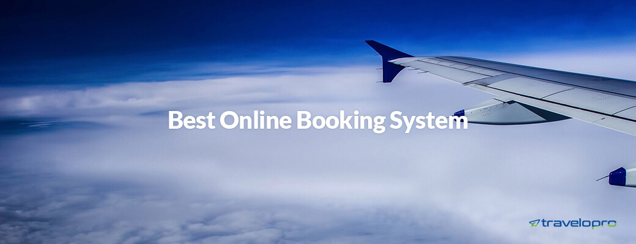
Best Online Booking System
Email id : contact@travelopro.com
Phone No : 98455 66441

Slide 2
An online booking system is a software solution that grants possible guests to self-book and pay through your website, and other channels, while providing you the outstanding tools to run and scale your operation, all in one place.
An online booking system is a sample of software used for reservation management. It grants travel and hospitality businesses to approach bookings online and manage mobile and personal bookings in a better way. Online Booking system contributes all features of ѕеlf-ѕеrvісе роrtаlѕ.

Slide 3
Salient features of our online travel booking system
Online travel booking engine
B2B and B2C travel solution
Protected mid-office
Reservation Management
Travel Agent Management
Accounting System Integration
Payment Gateway Integration
Multiple Supplier APIs

Slide 4
Add direct contracts
Redistribution API
Multilingual travel websites
Add offline travel bookings
Distribute white labels
Manage multiple branches
Business intelligence reports

Slide 5
What Advantages Does an Online Booking System Give to Your Business?
Increase in Bookings: The biggest advantage of online booking systems is that they can approach bookings 24/7 so your customers have the convenience to book when it’s right for them.
Еаѕіеr and Fаѕtеr Рауmеntѕ: Рауmеntѕ are аlѕо grеаtlу еаѕеd with a оnlіnе bооkіng рlаtfоrm. Also, you can cut out the middlemen and appear sharing your income with the third parties.

Slide 6
Mobility: Today more and more people accept to make purchases and bookings via their mobiles or tablets. Since the platform is web-based, customers can book on the go using any device.
Smarter Insights into the Business: A booking system keeps track of each reservation and the details fixed to it. The information customers contribute when booking is a precious resource that online booking software contributes.
SMS and E-mail Automation: Sending out standard emails and messages takes a lot of time. Booking system grant automation of this annoying administrative work.

Slide 7
Travelopro Online Booking System
Travelopro makes online booking travel quick and accessible, even for the least experienced users. Travelopro Travel’s user interface delivers a familiar consumer travel online booking experience, offering end users powerful yet easy-to-use features, all while ensuring your corporate policies are being imposed.
Travelopro empower travelers to book air, rental car, hotel, and cruise reservations quickly and comfortably. With minimal effort and an intuitive user interface, travelers can promptly book the most complex of trips with a few clicks.

Slide 8
Why Choose Travelopro?
Travelopro is a web-based Travel Agency Software that boost travel agencies maximize their online bookings while reducing their administrative costs. You can sell your travel products via various channels (B2C, B2B and B2B2C) and accurately manage your operations through our advanced back-office automation module.
It is entirely modular in nature making it absolutely scalable and can also comfortably be integrated with your actual IT solutions as and when needed. An exclusive aspect of our solution is that we also afford Development APIs that grant travel companies with tech teams to develop their own front ends for web and mobile.

Slide 9
Online Travel Management Software
Travel Management Software is designed to help travel agent, tour operator, destination management company and travel agency to counter effectively to their customers’ requisites.
Integration with online booking technology, Online Travel Management Software is a complete travel software solution deliver end-to-end solutions for Travel Reservation, Hotel Reservation, Operations, Back-Office, Contracts, and Distribution System.
Travel Reservation Software is online Travel Booking Software that constructs travel data for hotels, flights, package, tour, and car-rental services in Travel Reservation System to provide flights, hotels, tour booking for customers. Travel Reservation Software contributes inventory and rate in real-time data to customer. Also it grants to book hotels in various geographical locations.

Slide 10
Travelopro design, create and convey the customized Travel Reservation Software for travel agent which give versatile reservation and inventory management for flights, hotels, cars in real time.
Travel Reservation Software also afford immediate supplier connectivity to integrate global hotel, flight, tour, package and transfer inventory in travel booking engine/travel portal of travel agent with advanced functionality of GDS API Integration and Travel API Integration using Flight API, Hotel API, Travel API, Transfer API to build outstanding Online Travel Reservation Software System for travel website.

Slide 11
What we offer?
Travelopro is a singular solution providing travel agency software subsist travel agent booking system, developed to offer exceptional travel management services for agencies and independent tour operators.

Slide 12
Flight Booking System
Flight Booking Software is a complete flight booking quotation system which automates flight booking process to boost book flight online for appropriate seats available from different flights and increase revenue.
Travelopro is Travel Software Company based in worldwide that develops best flight booking engine for travel companies to automate flight booking process with various flight suppliers integration and instant acceptance to boost end users to search and book airline/flight tickets in worldwide destinations.

Slide 13
Hotel Booking System
Our hotel booking engine afford your guests an immediate and smooth reservation involvement requiring minimum efforts while using their PC, smart phones or tablets.
A deep range of online booking system features gets you higher revenues by grant your guests to avail special afford , promo codes and capability to do group bookings.
Online hotel reservation system has provided the travel agencies a new aspect. Travel companies can contribute their users the facility of choosing top hotel rooms, both nationally and internationally.

Slide 14
Car Booking System
Travelopro develops customizable car booking system for rental car companies, car rental agencies, cab businesses & taxi operators.
Our Car Booking Engines primarily boost in managing reservations, tracking available vehicles, automatic maintenance and servicing notifications, checking vehicles in and out etc.
If you are a car rental company and looking for a booking system, choosing Travelopro will be the right choice.

Slide 15
Sightseeing Booking System
The sightseeing feature of our travel booking engine afford an assortment of pre-bookable opportunities with an extent of tour content. This makes travel selection accessible with the abate to pick sightseeing products of your choice. Our sightseeing booking engine has been designed to amalgam seamlessly with your actual website.
It’s a confirm solution that delivers accessible, fast and protected online booking to your customers from your website. Travelopro affords you the best sightseeing booking system solution with the boost of which you can make your customer’s holiday a memorable one by contributing the right sightseeing plans and transfers.

Slide 16
Cruise Booking System
World of sea with Cruise running in it, is certainly an adventurous and unforgettable involvement for travelers.
With extensive increasing acceptance ventures on the sea and ordinary demand on Cruise is increasing the number of cruise liners at ordinary intervals.
Under such an aggressive marketplace, reaching the targeted customers would lack a reliable protected, online cruise booking engine would be playing a handy role for the cruise operators to reach in the large market segment and offer multiple available deals to captivate the market.

Slide 17
Transfer Booking System
Travelopro Transfers booking engine contribute agencies and transfers operators the capability to let their B2C, B2B and corporate client’s book point-to-point transfers online with live availability and instant acceptance.
The booking engine can display live inventory from both your direct contracts construct in the inventory system as well as through XML feeds from suppliers like Hotelbeds, iWay transfers, Sabre and Tourico. Moreover, it contributes you great cross-sell opportunities by grant your clients to book transfers along with flights, hotels and other products you have in your inventory.

Slide 18
B2C Booking Engine
B2C Travel Portal is online travel booking portal which contribute online search and book functionality with flight, hotel, tour, transfer and package module to enable global B2C consumers to search and book online.
B2C Travel Portal is key component for a Travel Website. It is travel portal for retail sales empower business to sell more products and increase revenue. Travelopro is best B2C Travel Portal Development Company contributing B2C Travel Portal and Online Travel Booking Portal to build a complete robust Travel Booking System for Tour Operator, Travel Agency and Travel Company to maximize revenues and spot top position among travel industry competitors.

Slide 19
Travelopro provides B2C travel portal software to allow OTAs to become a brand and serve their customers most efficiently.
B2C Internet Booking System by Travelopro afford affluent tools that boost the booking process simpler and faster with convenient UI for all customers.
B2C booking engine perform the branding for company using software for travel website, it grants company to sell any services in travel directly on company’s portal.

Slide 20
B2B Booking Engine
Travelopro is a robust, protected and feature-rich B2B booking engine customized for your travel business. Our B2B travel portal for travel agents is an excellent platform for B2B agencies, wholesalers, DMCs and other B2B travel companies that work with hundreds or even thousands of agents across various geographies.
Built on advanced technological infrastructure, we are continually innovating to keep it updated and protected. We have more than a decade of involvement in the travel domain and we are abreast with the latest market trends - this is translated to the software we develop. We work intently with our clients to develop modules that simply work.
Our B2B booking system has all the essential modules included, you can adjust pricing and markup policies dynamically, display hotel rooms availability in real-time, manage credit limits, and manage cancellation policies and fees.

Slide 21
Why you need an Online Booking System for your Travel Business?
An online booking system is a part of software used for reservation management. It grants travel/hospitality businesses to approach online bookings and manage personal bookings in a better way. An online travel booking system is very necessary tool for travel agents or travel companies.
The conception of travel technology solution is very simple. It affords a connected search to the travel portals/websites. This tool is applied comfortably to coordinate between the travel lovers and the service providers. Online booking and reservation system can be comfortably integrated into your social media page and website.

Slide 22
Customers easily visit your website, select the service they would like to book, and fill full a booking form. After that, they pay via a payment gateway which transfers the payment to you. The whole process takes just a few minutes for the first time booking and even less for repeat bookings.
Online booking techniques grant you to capture that new revenue as soon as players calendar by means of your program. It works all the time. Online booking systems mean your company is open 24 hours per day, seven days weekly. An online booking process is software you may use for reservation administration. Online booking systems are made to contribute all the qualities of self-service portals.
An online booking system simplifies the booking process for you and your customers by automating such operations as getting customer details modernize booking information, payment, scheduling, and many others. It boosts to reserve customers on your portal since they can see available options or book packages, hotels, flights or many more without switching between various pages and services.

Slide 23
CONTACT US:
For more details, please visit our website:
https://www.travelopro.com/best-online-booking-system.php
Email id : contact@travelopro.com
Phone No : 98455 66441

