Slide 1

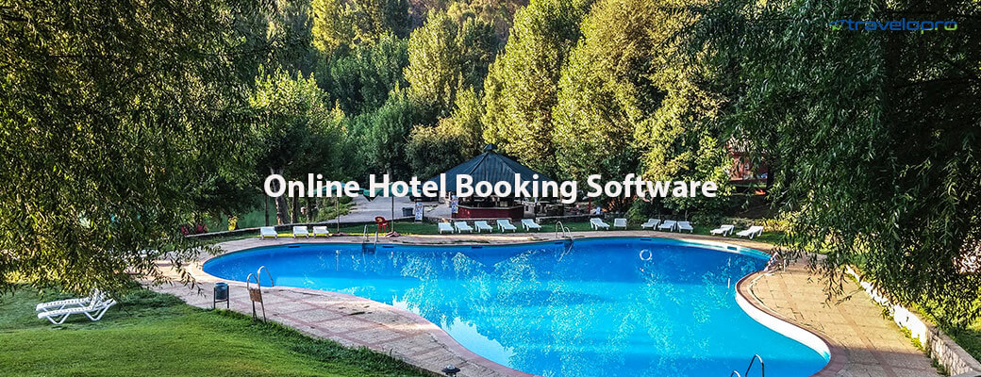
Online Hotel Booking Software
Email id : contact@travelopro.com
Phone No : 98455 66441

Slide 2
Travelopro is an online hotel booking software and property management system that works for all types of accommodation: hotels, motels, hostels, B&Bs, lodges & guest houses. Your bookings are easily accessible anytime and anywhere. The Hotel Booking Engine is one of the highly profitable solutions available to you. The margin of profit of B2C Hotel is more than B2B Hotel. So, the opportunity is massive.
Most important factor correctly combines the appropriate hotel wholesale suppliers with the right distribution capabilities to develop your sales significantly. Regardless if you’re searching for integrating a new hotel supplier to your present system, or starting a new hotel reservation system we offer more than just technology.

Slide 3
Best online hotel booking software is specialized in reserving hotels online with very best hotels available. By integrating this travel and tourism API with your own software solution, you as a travel service supplier can provide hard to beat travel related solutions to your potential clients. It helps in the travel and tourism business to help get the Hotel reservation done easily.
Travelopro Hotel API provides comprehensive descriptions including room types, images, and facilities, of over 500,000 properties worldwide. As one of the trusted API providers Globally specialized in Hotel API Integration. All our services are integrated, tested and maintained by an experienced team of professionals.

Slide 4
Travelopro is the best travel technology solutions provider that offers online hotel reservation systems, hotel reservation software for travel agencies, tour operators and travel companies worldwide. Our hotel reservation system offers travel agencies, hospitality partners and travel companies to manage their online booking of hotels effectively.
We develop hotel reservation system that supports B2B, B2C and also B2B2C business processes of travel companies. It provides users a unique, user-friendly and easy to use interface that improves the way people use the web today. Our Hotel Reservation System enables the tour and travel industry to provide bookings through the internet across various destinations globally.

Slide 5
Advantages of Travelopro’s online hotel booking software:
A wide range of features in the hotel booking API.
Search, book, amend, cancel bookings and 24/7 support.
Provide a custom-design solution as per your requirements.
Wider choice of hotels.
A quick, safe engine for travelers to book with great user interface.
Save time and effort by letting customers book your services online.
Customizable hotel booking system.
Enables hotels to be present in the global marketplace
Google maps integration so guests know how to find you.
You can increase conversions with a simple guest booking experience.

Slide 6
Online hotel booking software is connected with the top Hotel APIs and this integration is used to provide the best search results of hotels. We provide comprehensive descriptions including room types, images, facilities, ancillaries to the global market.
Our powerful and tailored hotel reservation system offers the ability to fully customize it according to your requirements. Our systems also make it more convenient than ever for individuals and travel agents to make reservations at their property of choice. Our focus is on delivering a smooth reservations experience for you and for all guests.
Travelopro lets you lower your costs and manage your hotel without compromise. It is designed to help you organize operations, and change things quickly & easily, when needed.

Slide 7
Everything can be managed from one point.
Offer a wide variety of rates and policies.
Custom console for Travel agents/Corporates to improve sales.
Confirm hotel bookings & get paid online from your website.

Slide 8
Travelopro is a trusted leader in the travel and hospitality industry for delivering one of the best hotel reservation systems that offer customized and personalized reservation engines for the hotel's website. Our hotel reservation system is feature-rich, robust and scalable and provides web-based OTA to the travel agencies, tour operators, and travel companies.
Our hotel reservation system is user-friendly and can easily be integrated on your website to provide error-free bookings for a hotel room for tourists. Our hotel reservation system offers your guests a smooth and quick reservation experience requiring minimum efforts while using their PC, smartphones or tablets.
Our modern online hotel booking software with seamless integration features enables hotels to not just maximize bookings via the hotel's own website but also via various online channels such as the GDS, OTAs, etc.

Slide 9
With our advanced and ground breaking technology and start-of-the-art security system, users are able to fully manage the rate, inventory, customize promotion, members, payment method, content, reports, etc. easily and with total confidence.
Our suite of data-driven travel solutions delivers the knowledge which you need to pick up the right guests at the right price and retain guest relationships for repeat travel business. All travel solutions in the suite are fully interconnected, mutually supportive and uniquely designed to make you successful by maximizing revenue for your hotel.

Slide 10
Features and benefits of our online hotel booking software:
There are many hotel booking software options available for hoteliers across the globe, but they can’t all be described as an easy-to-manage hotel booking engine.
You need to evaluate the features and benefits available in each system before you decide to implement a hotel booking engine at your property.

Slide 11
Here are the top features and benefits you need to consider when searching for the right online booking engine:
Quick and simple reservation process
Your booking engine should offer a short form for your guests to fill out when they are ready to book a room. They should not be forced to be redirected to a different site to complete their reservation or process their payment. In addition, you will want to select an online booking engine that comes complete with a “Book Now” button that attracts the attention of your target audience.

Slide 12
Mobile friendly
Your hotel booking software needs to allow you to accept mobile bookings. The number of mobile bookings throughout the industry continues to increase with each passing year.
Multi-currency and multi-language features
In order to attract a global audience, you need to have a booking engine that welcomes people from across the world. Your booking engine should adapt to different currencies and languages as necessary making it easy for guest to book online.

Slide 13
Ability to connect with social networking sites
You need a hotel booking engine that can connect with Facebook and other popular social networking sites. This allows your guests to book with you in a way that is convenient for them.
Hotel industry runs on the essentials of proper management at every stage. All internal teams/departments need to find a cohesive way to work together to create the ideal experience for the guests. As you plan to expand your hotel business, the task of manual data organization and maintenance becomes even more time consuming and cumbersome.
This is where an automated hotel booking system comes to your rescue. Moving to a hotel booking system provides hoteliers like you with a host of benefits that can improve efficiency and enable you to generate more revenue.

Slide 14
Today, most hotel bookings are made through online booking channels (OTAs). With Travelopro you can easily reach millions of potential guests. Say goodbye to manual updates. Travelopro saves you time with two-way integrations with all the important booking sites and automatically keeps your availability and bookings up-to-date.
Travelopro lets you lower your costs and manage your hotel without compromise. It is designed to help you organize operations, and change things quickly & easily, when needed. Everything can be managed from one point.

Slide 15
CONTACT US:
For more details, please visit our website:
https://www.travelopro.com/online-hotel-booking-software.php
Email id : contact@travelopro.com
Phone No : 98455 66441

