Slide 1

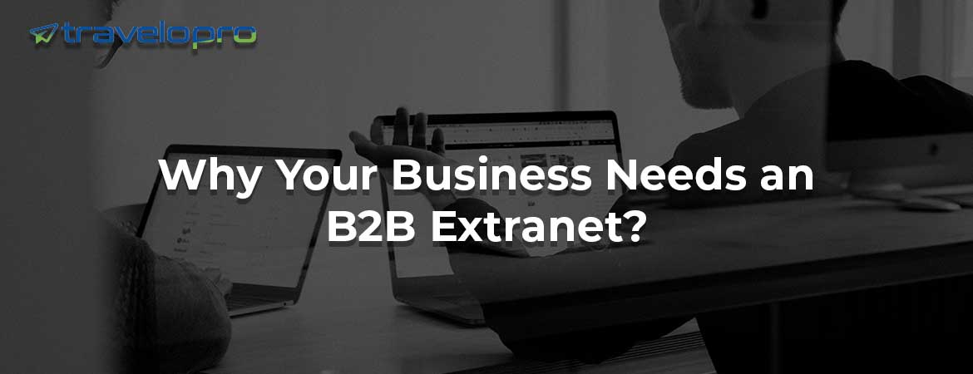

B2B Extranet

Slide 2
Overview Of B2B Extranet and Its Importance
Extranets are web-based, secure portals that let enterprises like hotels, airlines, and car rental companies manage and share essential data with reliable partners such as Global Distribution Systems (GDS) and Online Travel Agencies (OTAs). The central nervous system is responsible for maintaining coordination between all parties. An extranet's primary function is to facilitate the exchange of information and the exchange of data and applications.
In the business-to-business (B2B) market, an extranet can give an organization a significant edge over its competitors by saving them money by reducing overhead costs and streamlining business functions.

Slide 3
A B2B extranet is a private network that allows travel suppliers, such as hotels, airlines, and tour operators, to connect with travel agencies, tour operators, and other industry partners to conduct business transactions. By utilizing encryption and multi-factor authentication to protect data from unauthorized access, a business-to-business extranet offers enhanced security.
B2B extranets are an effective way to boost business growth and efficiency. A well-executed system facilitates more effective collaboration between you and your clients and partners.
It offers greater customer service, enhanced productivity, enhanced security, and reduced procedures. The extranet offers a safe, instantaneous platform for working together with customers, suppliers, partners, and other parties, which enhances relationships and streamlines procedures.

Slide 4
Why Your Business Needs an B2B Extranet?
Improved Communication: A B2B extranet enables secure and efficient communication between your business and your partners, suppliers, or distributors.
Increased Efficiency: Automates manual processes. reducing errors and increasing productivity.
Enhanced Collaboration: Facilitates collaboration and information sharing between partners, suppliers, or distributors.
Better Data Management: Provides a centralized platform for managing and sharing data, such as product information, pricing, and inventory levels.
Improved Customer Service: Enables your business to provide better customer service by having access to real-time information and being able to respond quickly to customer inquiries.

Slide 5
Increased Revenue: Can help increase revenue by enabling your business to respond quickly to new business opportunities and to provide personalized service to customers.
Competitive Advantage: Provides a competitive advantage by enabling your business to conduct business transactions more efficiently and effectively than your competitors.
Reduced Costs: Can help reduce costs by automating manual processes, reducing the need for paper-based documentation, and minimizing the risk of errors.
Improved Security: Provides a secure platform for sharing sensitive information and conducting business transactions.
Scalability: Can grow with your business, enabling you to easily add new partners, suppliers, or distributors as your business expands.

Slide 6
Grow Your Business with Travelopro
Travelopro is a platform widely used by organizations to create business-to-business (B2B) extranet collaboration sites. Numerous external sharing features along with complementary sharing features make Travelopro a great choice when it comes to a simple and secure B2B extranet site.
Travelopro’s B2B Extranet is a simple integration and seamless solution enabling businesses to collaborate with other businesses in a safe and secure environment. Travelopro’s expertise in extranet development ensures that your business is equipped with a solution to meet your needs.
From secure extranet access management to dynamic extranet products and services, Travelopro delivers solutions that empower businesses to grow in a competitive marketplace.

Slide 7
Through the use of an extranet system, business-to-business agents may upload their hotel contracts and inventory to the Travelopro system. As a result, they market their goods both directly and online. In a similar vein, the booking extranet system is designed to facilitate ongoing online booking and hotel reservation transactions. Initially, the hoteliers can manage their complete catalog and personal business in the CRS. It also facilitates the setup of rooms, facilities, and other features.
Our B2B Extranet comprises a main module, which includes basic functions such as portal structure, parameters, user definitions, and authorizations; and, Web pages that operate in integration and that have been developed especially for this module.
The module enables the travel agencies to gather and manage their own contracted hotels, tours, or activities suppliers, which they can subsequently make available to other customers through B2B or B2C sales channels or as XML API.

Slide 8
Our B2B web extranet portals are designed to help businesses of all sizes enhance their online presence and operate more efficiently. This business model is particularly useful for manufacturers, wholesalers, and distributors as it allows them to connect with the specific customers in their niche. By providing a platform for businesses to interact with one another, our B2B portals enable companies to streamline their operations and work more productively.
We guarantee our clients profitability, increased consumer trust, improved customer service, and a reduced margin of error. In addition, we provide our clients with a platform to build enduring relationships with their potential clients, strengthening them.
Our travel agency B2B extranet module enables them to make reservations using the online booking system and handle their reservations independently. Travel agents can make reservations via the online B2B sales channel, which includes partner agencies, GSA multiple branches, and the B2B module's multi-level distribution feature, which lets partners build their own agent network.

Slide 9
Agent management will offer excellent benefits by giving its employees and agents different logins with their designated duties. B2B agents can provide sub-agency and higher markup prices, while B2B administrators can monitor the credit limit.
Travelopro's advanced B2B extranet system increases bookings and offers features to ensure booking at the last minute. It keeps your property booked all the time and gives a flawless booking experience to travel agencies.
For travel businesses looking to scale, increase efficiency, and improve partner relations, a B2B extranet is a powerful tool that offers both immediate and long-term advantages.

Slide 10
With the B2B Booking Extranet, you can simply boost client loyalty and efficiency. Many clients are less stressed when you make last-minute reservations as an accommodation provider. Furthermore, clients that have benefited from Travelopro's services have achieved success across the board.
Travelopro has been in the industry for years, guiding customers with B2B Travel Extranet development services. Throughout the years we have strived hard to reach the goals. We are eager to have a project where the agents can directly connect with the consolidators.

Slide 11
Why Choose Travelopro for Your B2B Extranet?
Streamlined Communication: A well-designed business-to-business (B2B) extranet facilitates smooth communication between your company and its clients and partners. It lets you keep all of your interactions transparent while enabling you to measure progress and safely communicate significant data.
Improved Operational Efficiency: Travelopro's extranet solutions reduce the load of doing repeated chores by automating them. Additionally, it streamlines your supply chain and centralizes data administration. From order processing to inventory monitoring, Travelopro is dedicated to assisting companies in gaining substantial efficiency gains.

Slide 12
Scalability and Flexibility: Travelopro creates extranets that expand along with your company. With scalable extranet platforms, Travelopro can meet your unique needs, whether you're a small business trying to grow or a major organization seeking cutting-edge capabilities.
Superior Customer Experiences: Travelopro's extranet solutions provide your clients access to customized portals where they may download resources, track their orders, and keep informed. This increases customer satisfaction and develops loyalty.
Data Security and Compliance: In the digital era, security is one of the primary issues. To secure your data, you must use appropriate security measures. Travelopro employs cutting-edge security measures to guarantee security and compliance with legal requirements.

Slide 13
What Are the Benefits of Having a B2B Extranet?
Having a B2B extranet benefits all parties involved in your business:
Benefits for your clients:
Improve customer service and order management resource efficiency: Technological changes have revolutionized consumer behavior. Your customers are no longer limited to purchasing your products or services but now have greater access to a wealth of information, compare results, and interact with their suppliers in a different way.
Greater accessibility: each customer will have private access to all their information (financial data, order status, stock queries, merchandise availability, access to all your business catalogs, etc.).
Simplify your customers' purchasing process: Your customers will be able to make orders quickly, simply, and intuitively with the help of B2B solutions.

Slide 14
Benefits for your company:
More orders mean more revenue: a B2B extranet uses the Internet, a globalized medium, so its implementation will facilitate your access to new markets, you will be able to promote your products, and you will favor cross-selling of your business.
Improve expense control: Automating and simplifying business processes reduces transaction costs and simplifies your company's internal management.

Slide 15
Reasons to use a B2B extranet
A B2B extranet can be a useful tool for the following business needs:
using inventory management, computerized order tracking, and online ordering either internally or externally with specific partners
embracing new technology and allowing the exchange of company information and transactions to operate flexibly to satisfy the expectations of larger corporations
enabling businesses to communicate with their suppliers and trading partners in an economical and effective manner and giving them round-the-clock access to the information they require
automating the trade processes between you and your trading partners to improve business ties and solidify your company's position in their supply chain

Slide 16
Who Uses A B2B Extranet?
There are several types of partners or collaborators that may use a B2B extranet provided by a company. Some of these include vendors, suppliers, distributors, customers, and other multiple business partners. Each type of partner may use the extranet for different purposes.
Travel Agencies: Travel agencies use B2B travel extranets to book travel products, such as flights, hotels, and packages, on behalf of their clients.
Tour Operators: Tour operators use B2B travel extranets to book travel products, such as flights, hotels, and packages, for their tour packages.
Travel Suppliers: Travel suppliers, such as airlines, hotels, and car rental companies, use B2B travel extranets to distribute their products to travel agencies and tour operators.

Slide 17
Online Travel Agencies (OTAs): OTAs use B2B travel extranets to book travel products, such as flights, hotels, and packages, on behalf of their clients.
Travel Management Companies (TMCs): TMCs use B2B travel extranets to book travel products, such as flights, hotels, and packages, on behalf of their clients.
Destination Management Companies (DMCs): DMCs use B2B travel extranets to book travel products, such as flights, hotels, and packages, for their destination-based tour packages.
Travel Wholesalers: Travel wholesalers use B2B travel extranets to book travel products, such as flights, hotels, and packages, for their clients.

Slide 18
How Are B2B Extranet Used?
Extranets enable the wider distribution of and access to information and transactional capabilities more efficiently and securely than, for example, email or even a real-time collaboration network.
Booking Travel Products: A B2B travel extranet can be used to book travel products, such as flights, hotels, and packages.
Managing Inventory: A B2B travel extranet can be used to manage inventory levels, track availability, and optimize pricing.
Processing Payments: A B2B travel extranet can be used to process payments securely and efficiently.
Sharing Documents: A B2B travel extranet can be used to share documents, such as travel itineraries, invoices, and receipts.

Slide 19
Communicating: A B2B travel extranet can be used to facilitate communication between travel agencies, tour operators, and travel suppliers.
Managing Rates and Availability: A B2B travel extranet can be used to manage rates and availability for travel products.
Creating and Managing Bookings: A B2B travel extranet can be used to create and manage bookings, including making changes and cancellations.
Tracking Commissions: A B2B travel extranet can be used to track commissions earned by travel agencies and tour operators.
Providing Reporting and Analytics: A B2B travel extranet can be used to provide reporting and analytics capabilities, enabling travel agencies and tour operators to track sales, revenue, and other key performance indicators.

Slide 20
Conclusion
In travel booking systems, business-to-business extranets are more than simply tools; they represent the foundation of the contemporary travel sector. From guaranteeing real-time information to maximizing pricing and promotions, they enable companies to maintain their competitiveness and satisfy the constantly rising needs of modern tourists. Extranets will continue to be at the forefront of innovation as technology develops further, boosting productivity and providing outstanding customer service.

Slide 21
CONTACT US:
For more details, please visit our website:
https://www.travelopro.com/b2b-extranet.php
Email id : contact@travelopro.com
Phone No : 98455 66441

