Slide 1

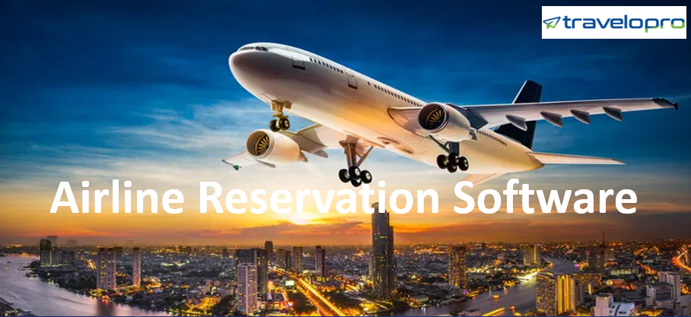
Airline Reservation Software
Email id : contact@travelopro.com
Phone No : 98455 66441

Slide 2
Travelopro offers airline reservation systems which provide modern, flexible reservations and inventory management solutions for airlines including call centre, travel agency and internet ticket sales and bookings.
Our airline reservation software provides a stable platform to airlines of all size and with industry standard interfaces to all external reservation systems including GDS system, other airline CRS systems.
Airline Reservation System is online booking engine associated with worldwide GDS systems including Amadeus, Galileo, Travelport and Sabre, which consolidates the data from all the airlines. Airline reservation system incorporates airline schedules, fare tariffs, passenger reservations and ticket records.

Slide 3
Why Airline Reservation System Software Useful for Tickets Booking?
It is used for the reservations of a particular airline and interfaces with a global distribution system (GDS) which supports travel agencies and other distribution channels in making reservations for most major airlines in a single system.
We provide airline reservation and booking software design services for inventory management modules, including centralized database architecture for real-time data, flight schedule and seating management and accommodation.

Slide 4
With our airline booking system, boost your online ticket sales compare to direct flight booking. You can easily track reports of sold tickets and view the list of passengers and most-used airline companies.
Travelopro’s Airline Reservation System increases your brand’s loyalty and maximizes the average value per transaction for new and returning customers. Our airline booking software is a perfect fit for all of these goals.

Slide 5
Discover the Advantages of Using the Travelopro Airline Booking System
Travelopro provides a travel distribution and passenger service system software used for airline merchandising, bookings, and distribution.
Airline Reservation System software is needed to manage flight ticket booking, scheduling flights, delivery of necessary information to the end-user. To be competitive in the market in terms of turnover, goodwill and profit generation it is necessary for the airline companies to have an effective and best reservation system.
The Airlines Management System has benefited both the airline industry and the customer as well. For the airline industry, it has benefits such as accuracy of the information, resolving grievances of the customer, getting the faith of customers, building goodwill in the market and increase in the surplus, etc.

Slide 6
For the customer, it has benefits such as easy and timely access of information, the security of their money, a saving of time, price comparison, flight ticket software, ease in reserving and getting offers from several airline companies.
We are a dominant travel technology company offering travel technology products to companies engaged in the travel sector. Our products assist travel businesses in delivering easy services to their guests.
Through API/XML integration of GDS such as Amadeus, travel website we help in upgrading end-user experience by providing them updated information as per their need. We provide business processes to fill your airplanes, logic for your front lines, and technology to take your airline to the next level.
We deliver travel technology products for hotels, Flight booking Engines, relocation, excursion, and customized packages, etc. We have deployed our work toward enhancing the efficiency of the B2B travel booking system, B2C and B2B2B corporate universally.

Slide 7
We use cloud-based and fully integrated solutions that provide support to all airline business models. We are built entirely on new technologies to provide a flexible system and business model for highly efficient operations.
Our advanced system provides an excellent platform for streamlining operations, controlling costs, and achieving optimal performances. Airline reservation software is one of the critical parts of any flight reservation engine.
The goal of an airline company is to increase its turnover along with maintaining a name in the airline industry. The ticket booking software development plays a significant role in achieving the goal of the company.
It offers an airline booking software which processes on merging with global GDS systems such as Amadeus, Sabre, and Galileo flight reservation system. The merger of the GDS flight booking system with flight helps in gathering information from different suppliers which work as one of the best flight search tools.

Slide 8
The majority of travel companies are looking for an online airline management system these days due to its real-time data accessibility.
We help small-medium size airlines to run their operations with big airline tools without breaking their budget, using different pricing of RBD classes and fare bucket management method.
We provide a complete, customizable, and enterprise system that caters to the requirements of low cost, hybrid, and traditional airlines.
Generally airline reservations system functionality includes the internet Booking Engines for reservation, reservation/booking management, airline hosting system and services, airline scheduling, fares engine, internet booking engine statistical module, airline inventory hosting & management, airline IBE hosting, XML interfaces for distribution of airline system data, and travel agent reservations, full GDS type A & B reservation connectivity, direct access from all GDS systems for reservations, GDS E-Ticketing.

Slide 9
And also includes Amadeus, Sabre, WorldSpan, Galileo, and Abacus. And also cover the interline with other airlines, IATA Interline E-ticket, IDEC Interline Settlement for IET, Airport Departure Control System module, PNL send to other Airport Departures Control Systems, Airport APIS (APP) transmissions, Reservation Reporting Modules, 3rd party system interfaces, Scalable database system for all sizes of airline, and Hosting of other systems.
In-Flight Reservation System we process the Airline Inventory Management, Airline Hosting System, Reservation Management, Booking Engine, B2C – End User Reservation, B2B – Travel Agents Reservation, For IATA and non-IATA Agents, E-ticketing, Third Party Insurance, XML Out, Airline Mobile Booking App both Android and iOS.

Slide 10
GDS Solutions: That has full control of all your sales outlets and simplifies your sales operations with our Global Distribution System which is fully integrated into our system. Our GDS solutions develop communication and visibility with travel concern and save time, money and above on booking processes with interactive, real-time data on airline seats and availability.
The best online booking engine provides the fastest way for flight reservations online through their user-friendly interface. The installation of airlines reservation system by travel businesses act as strong flight search software.
The logical and productive application of the online air ticket booking system helps the end customer of the company in selecting the best package provide by some distributors. We provide traditional GDS platform, codeshare links, and interlines carriers to enable you to optimize and extend the reach of your airline company.

Slide 11
And we provide end to end airline reservation systems for the aviation industry which includes PSS, Distribution, Analytics, Frequent Flyer, IBE and much more.
In addition to this, we do help airlines to further aggregate and distribute their contents broadly through some other channels like GDS systems, OTA and IBE for airlines.
For an Airline, the reservation system is mission-critical and we provide a complete hosting solution for airlines and their reservation systems.
We use that latest state of the art technology to provide airlines with a system for all their flight reservations on a robust platform that is flexible and can adapt to any style of the airline.
Productive and stable systems are essential to the airline industry which is why we have spent many years designing an architecture specifically suited to the nature of the airline industry which usually requires 10’s of 1000’s of users to access and use the system concurrently.

Slide 12
With all users of the system being online at all times the system remains track of directory and passenger reservations in a real-time environment, and improve directly with all transactions.
Our internet-based system provides all of the ability of the traditional computerized booking systems, but in a user-friendly format that is easy to use and understand and always online.
Our Airline Reservation System provides a modern, flexible reservations and inventory management solutions for Airlines including call center, travel agency, internet engine, GDS and online booking.
By executing our system, airlines can ensure that bookings can be created not only by their airline staff but also by any travel agent using a GDS system or further airlines that have a naturalized Interline Traffic Agreement utilizing our interline interface.

Slide 13
Airlines use our Reservations System to fully manage their inventory and yield/revenue to maximize their profits.
The systems also provide airline management support by subscribing financial, executive, back-office problems, organizing, and airline load data, decision help for control of overbooking, offer seat allocations and submit management that can be used to balance the number of special fare seats based on the number of bookings.
Airline ticket representatives can access the reservation systems to form flight arrangements, view current bookings, and check traveler lists, as well as many other responsibilities.
Airline agents, as well as travel agents, can issue both paper tickets and e-tickets for a booking made on the system which conforms to the IATA standard. E-tickets are also provided online via the internet reservation engine for any reservation made by the public.

Slide 14
And our passenger booking and distribution system offers integrated solutions and strong high-performance technologies that assist airlines of all business models to grow.
We spread over a broad range of customer and business management pillars. We also provide an excellent platform for addressing recognized industry problems and raising the opportunity bar for all sizes of business models.
We enable airports and airlines to sell ancillaries, tickets, and airport services to their customers by using multiple distribution channels. We provide business processes to fill your airplanes, logic for your front lines, and technology to take your airline to the next level.
With intelligent design and smart features, we help airlines stay profitable. It’s the tool that helps your business operations run smoothly and efficiently.

Slide 15
You will have the power to market each seat the way it needs to be - day by day, hour by hour, minute by minute, flight by flight, and passenger by the passenger. We also provide safety management applications, plus Passenger Name Records (PNR), and No-Fly List data, as well as traveler app programming.
Increasing revenue is easy when you seriously raise operational efficiency. Our web-based Airline Reservations System is the heart of the complete airline management solution and has been designed to be easy for employees to learn and operate.
The system allows scheduling, booking, reporting, customer management, and other functions. Through our airline ticket booking software, our prospective clients get the option to select from several alternatives which finally convert them as a package for fulfilling the informational need of the customer.

Slide 16
The customized package also includes selected best hotels, travel vehicles, rented vehicles, tour and flight API integration for travel agents, etc.
Airline Reservation System
Airline Reservation Software
Airline Inventory Management
Airline Booking Engine
Reservation Management system for Flights, Hotels, Cars, Holiday Packages.
B2B & B2C Reservation
GDS Integration (Amadeus, Sabre, Travelport, Galileo)
3rd Party Interface
Mobile App development for Airline Reservation System

Slide 17
Benefits of Our Airline Reservation System
Integration with various travel product suppliers via unified connectivity gateway
Ability to design, deploy and evaluate the airline booking software
Effective airline booking engine implementation and support
Smart intuitive & mobile friendly user interface
Seamless and fast one-way, round trip & multi city flight search and book process
One-stop-shop travel experience
Multi-language and multi-currency support

Slide 18
Integration with secure payment system
Connection to multiple airline reservations system (GDS’s)
Connection to your B2B and/or B2C portal
Multiple filtering options
Sorting by price, flight duration
Real time availability of special promotions and discounts

Slide 19
CONTACT US:
For more details, please visit our website:
https://www.travelopro.com/airline-reservation-software.php
Email id : contact@travelopro.com
Phone No : 98455 66441

