Slide 1

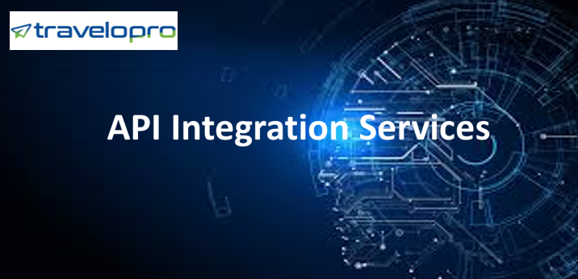
API Integration Services
Email id : contact@travelopro.com
Phone No : 98455 66441

Slide 2
What is API Integration?
API stands for Application Programming Interface. An API is a software intermediary that allows two applications to communicate with each other. In other phrases, an API is a messenger that delivers your request to the provider that you’re requesting it from and then delivers the response back to you.
These days, the APIs are everywhere! From submitting your information to buying something online to your mobile phone, all things come back to APIs. APIs are also usually referred to as third party services or external platforms.
APIs are essential tools that ensure streamlined operation and performance of applications and web systems. The API is a collection of protocols, definitions and tools that allow coordination and engagement among software components.

Slide 3
It enables a user to communicate with a web-based tool or application. With an API, Customer can use an interface to request something from an app.
The application will then transfer the data to the API, which will process information and provide a response. The API helps to convert the returned data into something the user can understand.
The API integration can be defined as the process of creating a means for two or more APIs to share data and communicate with each other without human interruption. This helps companies to simplify their processes, enhance seamless data exchange, and incorporate existing applications.
Travel API Integrations allows travel sites to show the list of packages hotels, airlines, and leisure visitors to the site. Travelopro designed Our API Integration Services around the complete list of travel products.

Slide 4
Travelopro Travel API directly connects you to all the data you need to build innovative sites or applications. We will implement the API Integration into your website. Once Your API has been integrated with your website, you will immediately start to discover the great value-added advantage and benefits it offers to your business and clients.
By integrating our travel API with your own software solution, as a travel services provider, can offer your potential customers unbeatable travel-related services such as car booking, flight booking, and hotel booking. APIs allow online travel agencies or booking agents to access global travel content such as hotel information, images, rates from different suppliers.
API integration has become essential in the modern world due to the explosion of cloud-based products and apps. API integration has proved to be the much-needed solution as it allows the sharing of process and enterprise data between applications in a given ecosystem.

Slide 5
It enhances the flexibility of information and service delivery, as well as makes the embedding of content from different sites and apps easy. An API acts as the interface that permits the integration of two applications.
An API defines functionalities that are independent of their respective implementations, which enable those implementations and definitions vary without compromising each other. As a result, a good API makes it easier to develop a program by providing basic components.
The ability of API-led connectivity to allow systems to change as easily as plugging into a socket is key to the modern vision of enterprise IT. The API is an interface that, like your helpful waiter, runs and transfers data from the program you use to airline systems over the Internet.
Travelopro offered a standard way to access any application data or device. API integrations connect the various components of your technology platform to make them talk to each other and pass the data seamlessly.

Slide 6
How does API integration work?
API Integration is an end-to-end method for gathering data from the Travel API and enables you to incorporate third-party / GDS / XML API integrations into your site's booking engine.
Now, API plays an important role in the travel industry because Travel APIs directly link users to a creative website or app. With the help of API, customers able to take complete advantage of the best car hire, best deals on the flight as well as hotel, etc.
We provide Travel API, Third-Party Integration, Travel Booking API for travel companies across the globe. Travel APIs provided by Travelopro is quick and easy to integrate with your existing travel products.

Slide 7
Travelopro provides powerful Travel APIs that allow for a fully customizable experience. The Travel APIs is easy and user-friendly to communicate online with airlines, Tour operators, Hotel providers, and Car rental companies.
Travelopro has taken a unique approach to application and API integration by designing one-to-many integration workflows that are far more efficient and scalable than the point-to-point integration patterns offered by the competition.
Travelopro has experience with a large variety of Web-services and is experts using SOAP, REST and XML-RPC as well as JSON and other communication methods. Travelopro specializes in developing APIs that are easy to consume, well documented, and truly reliable.
APIs are completely changing how data can be used, and are setting new business models and product strategies. We allow flexible integration and functionality of existing products, enabling our developers to enrich and enhance services in new and creative ways.

Slide 8
Travelopro has recognized this shift in the importance of APIs, and the importance of delivering scalable and secure API development services for our clients. Travelopro implements internal and external APIs while leveraging exposed third-party web services.
Our industry-specific approach to handling APIs addresses problems relating to data access, business logic, information, micro-services, and communications. Travelopro develops specialized APIs for new and legacy enterprise applications.
Our APIs provides easy access to application data, functionality and business logic, as well as web services. Our API Development Systems Delivered Cutting-Edge Third-Party Integration Services.
Custom APIs reliably extend the functionality of your application with new and existing third-party systems and devices. We have worked hand-in-hand with them to develop and integrate a range of APIs for b2b and consumer-based APIs.

Slide 9
Our API integration programs aim to save you money by reducing development time and lowering costs. By using Travelopro custom-made API integration solutions, your business is sure to get the proper features and functionality.
Travelopro API integration solutions are used by various businesses, such as start-ups, medium-sized companies, and even large enterprises.
Travelopro builds a tailored-made solution specifically to the needs of your business, ensuring you get optimal performance throughout your whole business IT infrastructure. An API Integration Platform to Connecting Web-based Apps.
Third-party software used by many concerns may not give them access to all the features. This integration allows your concern to produce customized programs that straightaway links with your third-party software.

Slide 10
Why API integrations are important?
The importance of the Application Programme Interface also actually takes place in the integration of GDS. We help you build custom API integration that is perfectly suited to the requirements of your enterprise system.
Through our standard and customized APIs linking to third-party applications and websites, we allow clients to integrate business processes and enhance connectivity. Our clients use integrations with different Travel APIs as a reliable tool to develop their business.
Travelopro provides end to end API integration solutions in the travel domain based on which our assiduous software professionals build B2B and B2C travel booking systems.

Slide 11
As an API Integration Company, Travelopro provides integration services for flight booking, hotel reservation, car reservation, payment gateway, and SMS Gateway.
Travelopro provides hassle-free integration of both the SOAP and REST APIs. We help you avoid expensive, dangerous, and time-consuming re-engineering activities by aligning your API development priorities with your company's strategic objectives. Take advantage of a completely integrated experience, without disrupting any of your day-to-day operations or expanding your budgets.
Travelopro offers the best selection of Hotel reservation, flight reservation system, and XML suppliers from hotels, cars, tours and destination content to make your business grow via XML API integration.
Travelopro optimizes your internal management of APIs with a governance model to cover API identification, versioning, monetizing, and credentialing. We Provide comprehensive visibility into the lifecycle management of APIs for better business transparency and smarter decision-making.

Slide 12
A flexible enterprise API integration solution can give you the power to drive a connected business: improve performance through robust data access and device interoperability through multiple endpoints.
Travelopro helps enterprises to manage their complete API lifecycle and create the fastest and most secure path to digital transformation. Travelopro leverage a centralized API platform for creating, publishing, and managing APIs, to quickly create new APIs.
Our API Management and Integration Services give you the power of flexibility, scalability, and reusability, using code-free development tools so that you can deploy APIs at any given point.
Travelopro strengthens your API lifecycle at every stage, from design and monetization consulting to integration, analytics, and managed support. We also ensure full security and authentication capabilities so with regulatory standards.

Slide 13
Benefits of API integration
Real time booking system
Secure, reliable and robust reservation engine
Easy setup and flexible integration of travel search
Multiple API options
Customized interface to coordinate business highlights
Single platform for booking hotel, flight and car

Slide 14
CONTACT US:
For more details, please visit our website:
https://www.travelopro.com/api-integration-services.php
Email id : contact@travelopro.com
Phone No : 98455 66441

