Slide 1

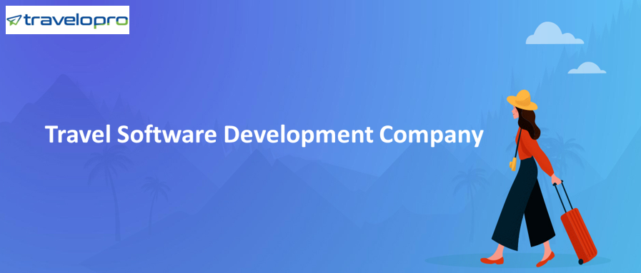
Travel Software Development Company
Email id : contact@travelopro.com
Phone No : 98455 66441

Slide 2
What Is Travel Software Development?
Travel Technology is a boom across the globe as its user friendly to worldwide Travel agents which provides the clients better fares, faster results and faster online booking.
Travelopro is a niche player in the market who has gained advanced Travel Technology tools which we will implement to set up the product from the scratch. Our travel software is mobile friendly so it can be visible in any screen sizes.
Travelopro is a leading travel software development company providing highly innovative software solutions for organizations operating in the travel and hospitality industry. Over the years, we have helped travel agencies, travel agents, tour operators, hotels, destination management and travel companies streamline travelling for their customers.

Slide 3
We are specialized in developing powerful and custom travel software that is engaging and interactive. We are experienced in offering efficient business solutions for travel software development. Our travel software development process involves initial project discussion, consulting, app icons, project management, design and development, testing, branding, and launching.
Our top-class custom software development company that delivers significant and robust custom software solutions for top organizations, small start-ups, and SMBs, in every corner of the world.
We empower travel and hospitality companies or individuals by providing seamless travel and hospitality software development services. We assist companies to streamline their experience and develop unique software products across travel and hospitality segment.

Slide 4
We help businesses such as transportation, hotels, lodging, resorts to convert digitally by providing custom software for air transport portal, hotel room management, resorts management system, vacations planning, car rental application, travel management.
Our main purpose is to help you overcome the complexities and competition faced by travel companies. As a Travel Software Development Company our services are for worldwide Travel Agent, Tour Operators, Travel Management Companies ( TMCs ), Destination Management Companies ( DMCs ), and everyone in the Travel Company.
Our long-standing expertise makes us well-positioned to serve as your reliable dedicated technology partner. We deliver profound travel industry knowledge and software development skills that made us a well-known provider of travel solutions for successful and competitive travel businesses.

Slide 5
Our software solutions are designed to serve customers who are always traveling and need to access quality data anytime, anywhere.
We integrate dynamic APIs such as payment gateways, booking platforms, and price comparison tools to enable customers to compare market prices to make a perfect booking according to their budget.
Our team of professionals performs not just technical analysis but looks for other feasibility options to offer you an all-encompassing, unmatched service.
Using cutting-edge technology, we develop top-notch applications for our esteemed customers around the globe.

Slide 6
Why Should You Hire Travelopro Developer for Travel Software Development?
If you are running a travel company and want to grow to build an online presence, then develop a traveling app by our developers. Whatsoever is your needs, our highly-experienced team will work for you and deliver the results that perfectly matches with your requirements.
We implement comprehensive and cost-effective technology solutions by delivering travel & hospitality software development that assists businesses scale, improve revenues, and optimize workflows. Our expertise covers revamping existing software, developing solutions from scratch, and integrating them with the current infrastructure.

Slide 7
Our travel software development company brings versatile services: from white label travel portals to revenue management. We provide travel portal design, development, testing services along with technical support. We know how to make your customer’s travel experience unforgettable.
We offer you the most effective Online Tour Operator Software, Hotel Booking Software, Flight Booking Software that facilitates the search for packages, hotels and flights all over the world and handle above all products at travel CRM software.
We help develop and maintain modern scalable travel software solutions, web and mobile applications customized to unique clients’ business requirements. We operate with travel agents and operators, hotels, restaurants, travel portals and booking websites, and aviation companies to convert the way people travel in a modern world.

Slide 8
We focus on providing smart software development services to tour operators, agencies, and travel organizations to help them simplify their operations, better client management, and build more effective marketing plans.
Our travel ticket booking portal accepts various investors to invest in the business and easily synchronize the necessary information related to their hotels, services, etc. Our development team is a specialist in developing and integrating standard APIs that grant you to add the payment gateways, price comparison table, ticketing platform, social media platform, and so on.
We maximize digital reach for companies like yours from B2B & B2C verticals, incorporating travel agencies, tour operators, travel & destination management companies & hospitality companies. Our software development services cover all aspects of the travel and hospitality business containing contactless hotel check-in capabilities, mobile room keys, touchless payments, in-app ordering, etc.

Slide 9
At Travelopro, we provide a robust travelling portal and other travel software solutions for all business verticals, including B2B and B2C. The travel ticket booking portal is nothing but a centralized platform where you can easily handle a hotel, agencies, and even customer data.
We as a team always make sure that this industry reaches its maximum height of excellence and popularity with the assistance of our travel & hospitality software development services. Our team has a long-standing expertise of building custom-made software for travel businesses of various types and specialization across the globe.

Slide 10
Our software is fit for Tour Operators, Travel Agents, Car Hire Companies, Coach Companies and local DMC’s offering them a booking platform, as well as management and accounts solution for flights, accommodation, transfers, sightseeing and tours. Our software solutions enable the use of integrated XML data feeds both inwards as well as outwards.
We create the best travel software tools and solution solutions for your needs at reasonable pricing and exceed your expectations. With a highly advanced documentation system with automated billing, receipts and vouchers. We assist to build your brand loyalty and improve ROI.

Slide 11
Our Travel & Tourism Development Company Expertise
To meet the needs of travelers, we encourage cutting-edge customized solutions for travel companies and organizations of all sizes.
Online Travel App Development
Ticket Booking Portals Development
Online Hotel Booking App Development
Payment Gateway That Is Secure and Reliable
GPS-Based Navigation Services
Integration of APIs

Slide 12
Tour By Virtual Reality
Integration of social media
Online Flight/ Bus/Taxi/ Bike App Development
Travel Agent App Development
Travel Management App Development
Holiday Planner App Development

Slide 13
How Travelopro Add Value to Your Travel Business?
You’re in the correct place if you’re looking for a travel website. We are a Travel & Tourism Website Development Services Company that develops integrated travel websites and provides online travel business solutions. We offer extensible B2C & B2B solutions to worldwide travel operators & hospitality businesses.
We deliver travel & tourism software development and digital solutions and for the Travel and Hospitality industry players to help them seamlessly connect to their clients, staff and vendors as the market requires and convert an indifferent guest into a loyal customer.
We use the latest Javascript and PHP based web development frameworks to build an immersive and engaging experience for your clients. At the same time, we involve all those features (filters, images, reviews etc.) that would make your customers quest for holiday information quick and comprehensive.

Slide 14
We leverage advanced technologies such as automation and data analytics to reorganize your internal processes and improve workflow. This has helped our customers remove process bottlenecks, cut process costs, shorten response times and boost productivity by several notches.
We contribute to your business strengthening through establishing a travel portal in compliance with the specifics of your business, be it a B2B or B2C sector. By delivering robust comprehensive solutions with the possibility to add a selection of modules, we establish a powerful relationship between you and your clients.
Our team of expert developers has experience working with travel industry leaders. We strive to adhere to travel industry web and mobile app development goals as per business needs. Catering to several clients over the years in the industry has helped us gain the highest ratings on every portal.

Slide 15
Our technology can help you to establish your own online travel business and can also assist you to expand to second level with its amazing online products.
Our varied customization services surround solutions for social media integration, inventory management, customer service, API bridging application and product development.
We provide expert services for integrating your travel portal software with major GDS, XML, and any API to add modules such as social networking, price comparison, mobile ticketing, payment gateways, and more to provide you the finest travel management experience possible.

Slide 16
We march well ahead owing to its fully automated travel technology solutions. Among the several travel technology services which we provide, major are channel management software and GDS/API/XML integration for Flights and Hotels.
You can take advantage of our broad array of solutions that include travel tracking, hotel booking, travel assistant, travel destinations, flight booking applications, and much more. We take pride in offering time-bound and highly competitive business solutions to boost your travel business profitability.
We have the technical know-how and the expertise to provide a business with the most contemporary and cutting-edge technology. This would help organizations have an upper hand over its competitors and boost productivity.

Slide 17
Our developers are professionals in developing customized software solutions using modern technologies, social networking, location, mobile, and analytics that enables travel & hospitality companies with several benefits, such as enhance the customer experience, improve operations, decrease costs of travel distribution, generate new revenue streams, improved customer loyalty and many more.
Get in touch with us today if you are looking for a development partner who provides an entire range of custom software, application, and portal development services. We offer one-stop travel and hospitality solutions.

Slide 18
Why Choose Our Travel & Hospitality Software Development Services ?
Vast Tech Experience
Our in-depth knowledge and tremendous work experience allow us to offer high-quality services which help travel and hospitality businesses gain operational efficiency, save costs, and improve market presence.
Custom-Tailored Solutions
We build custom-tailored solutions for businesses that perfectly suitable with their business requirements and boost their market efficiency. Bring your business to us, and we’ll transform it into reality with our solutions.

Slide 19
Security
We ensure that each solution developed by our developers is completely secure, performs well, and is highly resilient to external cyber threats. Our experts test your software for bug detection so we can deliver outstanding solutions.
Dedicated Team
We own a dedicated and agile team of developers, project managers, strategists, innovative designers, and efficient testers who offer you a comprehensive range of development solutions that drive outcomes.

Slide 20
Independent Testing Team
We have an independent team of testers that cater to the needs of enterprises and large-scale businesses. Each member of the team has great experience in both automated and manual testing.
24/7 Support
We provide a comprehensive range of support and maintenance services to our customers so their business won’t suffer from minor technical issues. We work around the clock to provide you effective maintenance services.

Slide 21
Wrapping Up:
Partnering with Travelopro opens the doors to business efficiency through competitive technological solutions in the form of customized software applications. So, if you want to leverage technology for the advantages of your business, and outperform your competitors.
With our services, you can considerably improve your sales and broaden your customer base. We can become your best travel & hospitality software solution partner and take your business to next level.
We implement what we commit, and this fact sets us apart from others. Our services have benefitted several in the industry, and we strive to break our records by becoming the most reliable travel software development company.
Get in touch with us to provide your venture a distinct edge.

Slide 22
CONTACT US:
For more details, please visit our website:
https://www.travelopro.com/travel-software-development-company.php
Email id : contact@travelopro.com
Phone No : 98455 66441

