Slide 1

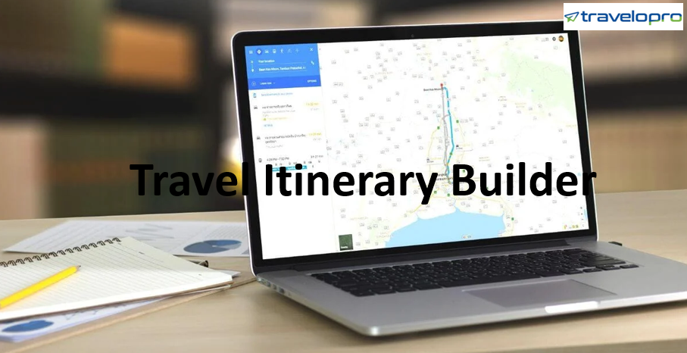
Travel Itinerary Builder
Email id : contact@travelopro.com
Phone No : 98455 66441

Slide 2
What is a Travel Itinerary Builder?
Travel itinerary builder is a comprehensive trip quotation system that includes Itinerary Creation, Itinerary Customization, Hotel XML IN, Hotel XML Out, Hotel Channel Manager, Hotel Extranet, and Own Contracting to assist agents in automating day-to-day operations and increasing bookings.
It is specifically designed for Tour, Travel, Packages, Activity, and Car Rental, and it automates the sales process for the best results. It is the travel software that helps tour operators or travel agents to keep track of activities such as scheduling, itinerary, meals, booking, and automate inventory.
It enables travel agents to create customized itineraries based on their needs, making trip booking easier and improving customer experience. It simplifies the booking process by providing a comprehensive booking engine with a trip builder booking system to increase bookings and revenue.

Slide 3
With today's plethora of travel options, identifying which itinerary is best is becoming increasingly difficult. If you are in the travel business, you understand the importance of a well-planned itinerary. A good itinerary not only provides information about the daily activities of a trip but also does so in a simple manner.
A robust Itinerary is the backbone of any travel professional. It is the exact layout that the travel agency utilizes for tour planning, including detailed data about the entire trip such as sightseeing, transportation, accommodation, and other details.
Customers simply look for appealing itineraries that provide good value. As a result, well-planned itineraries are essential for attracting and retaining customers.
Travelopro offers a simple yet extremely effective solution, through its Travel Itinerary Builder, Trip Planner, and Quotation Management Modules. These tools have a plethora of useful features that can help you save time while also increasing your sales.

Slide 4
Travelopro's Itinerary Builder Software is ideal for travel professionals and travel agencies that strive to provide their valuable customers with unique and memorable travel experiences. Whether it's planning a vacation, booking a hotel, finding a cab, or identifying a travel guide, we integrate all of them into our Travel Planner Apps.
With Travelopro's smart trip planning tool, you can simplify your travel. Use the best itinerary planner on the web which provides the entire travel data on a single dashboard.
This is where you can choose a destination, view maps, and add attractions, book hotels and activities to create the ideal itinerary. Your journey begins with determining the best route. Travelopro online travel itinerary planner tool is the simplest way to build and share your travel plans with your brand.

Slide 5
How to create Itinerary Builder Software that helps Organize & Plan Itineraries with Ease?
Travelopro, a leading Travel Technology Company, introduces travel itineraries to assist travel companies in providing the best trip plans and itineraries to their customers or end-users.
Travelopro's Travel Itinerary Builder Software is ideal for travel operators and travel agencies that strive to provide unique and memorable travel experiences to their valuable customers.
You can easily create and deliver the best itineraries and travel deals to your customers using our powerful and advanced itinerary creator. It doesn't matter if your user is looking for trips to exotic islands family vacations, cheap travels, or anything in between, you would be able to meet the needs of all.

Slide 6
Travelopro developed the Itinerary Builder for Travel Agents to provide a continuous flow of information to their travelers, including not only itineraries but also hotel information and flight tracking.
With our advanced and sophisticated itinerary planner, you can easily create and deliver the best itineraries and travel deals to your clients.
With the Travelopro Itinerary Management Software, you can assist your customers by providing hotel e-check-in and a simplified payment process, as well as a quick and easy chatting platform for quick conversations with respective team members. It also allows you to effectively resolve your customers' travel-related queries with a single click.
Tour Operator Itinerary Software is a modern itinerary creator that not only simplifies your initial search but also assists you in managing your other travel services – flights, hotels, cars, transfers, excursions, and so on. It is simple to modify and optimize your itineraries by adding images and amended text. These small details in an itinerary presentation can help you attract more customers.

Slide 7
It's a simple and interactive environment that's ideal for creating perfectly planned itineraries. As a result, the Itinerary Planning Software is able to quickly share a professionally designed itinerary while also ensuring strong customer follow-up after quotation sharing and converting them to business.
You can easily create and deliver the best itineraries and travel deals to your customers using our powerful and advanced itinerary creator.
Being able to provide all necessary information to clients in a timely and accurate manner will undoubtedly benefit the travelers, whether during the trip or before it begins.
The app served as a one-stop shop for all travel-related bookings, such as air and ground transportation, hotels, and sightseeing services.
Provide your visitors with destination reviews, find the best-rated hotels, search and book hotels at competitive prices, and get the best flight prices.

Slide 8
Travelopro’s itinerary builder for tour operators is simple to use and super fast to add multi-day tour itineraries. The itinerary should then be sent to customers via a mobile-friendly web link or PDF file.
The CMS panel provides a place for travel agents or tour operators to create holiday packages, add hotels, additional day-by-day itineraries, sightseeing, and so on. The same can be activated to display in either the B2C or B2B models.
We also provide the right online vacation planner solutions to our customers with a set of seasoned geeks that are up-to-date with today's technology. We are experts in the design, development, and implementation of GDS XML, LCCs, Hotel APIs, Transfer APIs, Car Rental APIs, Cruise APIs, and Travel Insurance APIs.
As a fully-focused travel technology company, we provide fully engaging package tour booking websites with a complete dynamic packaging system. This software enables OTAs to provide their customers with a variety of options for booking holiday packages or vacations of their choice.

Slide 9
Mentioned below are a few points that will inform you about the advantages of developing a detailed travel itinerary
Increase the Ease
A well-planned and detailed itinerary will offer travelers specific information for their daily excursion, such as where they will be today and what they will be touring, vehicle data, pickup and drop dynamics, and day-by-day travel time.
This would reduce the stress during the journey. This enables them to enjoy the excursion without assuming anything incorrectly and makes the travelers a happy client for life.

Slide 10
Build More Desirability
Each customer compares travel itineraries with those of other tour operators/organizations. Overall, they want the best for themselves after the money they're spending. As a result, easily accessible administrations, hotel stays, and meal plans, along with precise costing data, would assist them in contrasting given citations and others and making them more likely to be chosen among others. Something that adds more attributes to your arrangement than competitors.
Enables You to Win More Clients
A detailed itinerary from deals enables tour operators and travel agents to deliver the best travel service that will make the clients' revenue worth spending on vacation plans. It accomplishes them more than everything else does.

Slide 11
Excite Customers
Nothing makes a strong presence as a detailed travel itinerary does. It completely engages clients and leaves a positive impression on the creators in the client's heart. It acquires the regard for tour operators and inclining to what they say. When the itinerary is structured with each minor detail as needed, the client gets the impression that customized trips are being planned for them.

Slide 12
Partner with Travelopro for Travel Itinerary Builder Software that makes a difference
Travelopro introduces Travel Agent Itinerary Software to assist travel companies in providing the best trip plans and itineraries to their customers or end-users.
Travelopro helps you automate your customer’s travel with its unique and smart Travel Itinerary Website. It is the best itinerary builder software and planner, providing you with all of your travel-related data on a unified platform.
It allows you to search for and select destinations, view maps, add and modify attractions, manage hotel reservations, and other activities. It’s simple and interactive environment is ideal for creating perfectly planned itineraries.

Slide 13
Using various travel itinerary templates, our online travel itinerary creator enables travel agents to create and send visually appealing itineraries to clients. Travelopro's travel itinerary templates are complete with flights, transfers, hotels, cruises, and any other bookings made through the online booking process.
Travelopro's exceptional and advanced Itinerary Building Software for Tour Operators assists you in simplifying your customers' journey. It is the best itinerary builder software and planner, providing you with all of your travel-related data on a single platform.
It lets you search for and choose destinations, view maps, add and modify attractions, manage hotel reservations, and other activities. Its simplified workforce is best for generating perfectly planned itineraries.

Slide 14
Online Travel Itinerary Planner creates professional, pre-made itineraries as well as AI-based auto-suggestions. It is a time-saving and powerful tool; the single-click itinerary sharing process makes travel professionals more productive and profitable; online chatting functionality improves conversion ratios, and activity notification improves tour operator follow-up.
Our Best Travel Itinerary App helps travel agents and tour operators create day-by-day itineraries for their customers that include every aspect of a trip, no matter how complex.
Our Travel Itinerary Planner includes features for creating personalized, dynamic, and automated itineraries. Tour operators and travel agencies can create multi-destination, day-by-day itinerary details using pre-loaded products or by incorporating the tour builder with a diverse set of GDSs or APIs.
It is simple to combine services such as flights, accommodation, transfers, and activities to create an itinerary that meets the needs of any customer.

Slide 15
Our user-friendly tour software, which works well for both single-center and multi-center trips, allows travel agents and tour operators to easily create day-by-day travel itineraries.
Travelopro is the best itinerary builder and trip planner, bringing together all travel-related information on a single platform. It lets you search for and choose destinations, view maps, add and modify attractions, manage hotel reservations, and other activities. Its simplistic and interactive landscape is ideal for creating perfectly planned itineraries.
With its unique and intelligent Travel Itinerary Builder Software, Travelopro simplifies tour operator travel. Using cutting-edge technology, we assist travel agents in organizing, centralizing, and automating their agency's business operations.
It serves as a travel agency back-office automation system, offering services like payment schedules, supplier management, and invoicing. As a result, Travelopro simplifies the process and all of the agency's operations.

Slide 16
Access to product descriptions and other important details for critical hotels and services offered, which can then be added to your itineraries one by one. Include all services, such as flights, hotels, tours, and transfers, and choose whether to add each service manually or via a GDS or third-party API. Itineraries can then be saved as a template or created from the scratch each time.
Using our dynamic itinerary builder as your back office software, you can create pre-packaged or fully bespoke itineraries to attract your customers. It helps travel agents significantly reduce manual effort, turnaround time, and improve their bottom line.
This is why Travelopro Itinerary Builder App is one of the best travel itinerary apps available in the market, which has a range of benefits that will surely boost your business.

Slide 17
Key Features of the Travel Itinerary Builder that we Offer:
Easy set up for itinerary templates and predefined day-by-day packages
AI-Based Itinerary building system
Day-to-day schedule and activity management
Define your terms and conditions
Accessible from anywhere anytime
Activate / Deactivate itinerary
Reliable and sophisticated automated follow-up system
Automated payment follow-ups
Centralized Invoicing Systems
Create tailor-made itineraries in minutes

Slide 18
Book, modify or cancel a part or entire itinerary with a click of a button
Create quotations in minutes
Dynamic pricing of all your itineraries
It aids in pricing strategies
Streamlines and assists in every stage of planning like research, negotiation, administrative stage, marketing stage, and departure stage
Supplier management
Customer management

Slide 19
Auto Quotation
Hundreds of destinations to choose from
Fully customizable package
Package inclusion and exclusion master
Mobile responsive and user friendly
Send email to customers
24/7 itinerary builder

Slide 20
Benefits of Travel Itinerary Builder for Tour operators:
It also helps you manage and modify pre-loaded packages.
Its services are faster, saving you time and effort.
It simplifies data collection and itinerary creation.
Create and give unique themes for the Tour operator
All of the packages are completely customizable.
It is convenient because everything is on a unified platform
It is easy to manage
You can keep track of all your payments in one place
It has a simple interface that makes it easy to use

Slide 21
CONTACT US:
For more details, please visit our website:
https://www.travelopro.com/travel-itinerary-builder.php
Email id : contact@travelopro.com
Phone No : 98455 66441

