Slide 1

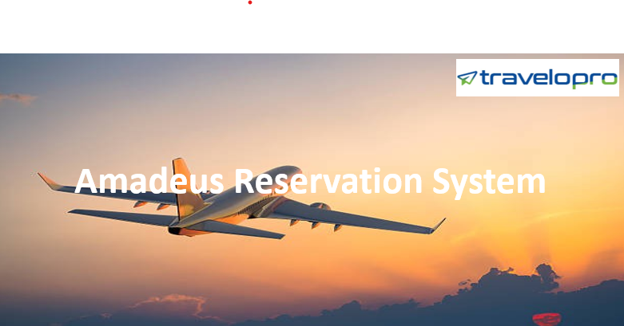
Amadeus Reservation System
Email id : contact@travelopro.com
Phone No : 98455 66441

Slide 2
Looking for Travel Booking Software? We offer fully flexible Travel Reservation System integrated with Amadeus GDS System.
Travelopro is a leading travel technology company, provides pre-integrated Amadeus reservation system for airlines, hotels, car rentals, holidays all over the world.
Amadeus GDS System is the world’s most widely used booking system for airlines which delivers the professional travel portal solutions for travel agents, tour operator & travel companies worldwide. It helps the agents to deliver comprehensive travel itineraries quickly and efficiently.
With Amadeus API integration your travel website will enable to find offers from over 500,000 hotels and 900+ airlines in 50+ countries across four continents.
Travelopro offers one of the most comprehensive Amadeus travel software that consolidates various travel services at a single place.

Slide 3
Travelopro pre-integrated with Amadeus airline reservation system which allows to aggregate information about flight schedules, seat availability and ticket prices from multiple airlines.
We integrate Amadeus GDS to access the inventory for flights, hotels, car rentals, holidays, transfers and sightseeing through web services. It helps the agents to deliver comprehensive travel itineraries quickly and efficiently.
Amadeus Reservation System is a computerized reservation system which enables agents to book flights, sell seats, issue tickets, book car hire and hotel accommodation.
It helps your travel business to grow by connecting the Amadeus GDS in the global travel marketplace.
Amadeus Central Reservations System (CRS) has the ability to manage and control distributions, bookings and rates via a comprehensive platform of capabilities.

Slide 4
Amadeus GDS is one of the most preferred GDS systems today. Global travel management companies are mainly using Amadeus GDS to access online travel content including airline, hotels, transfers, sightseeing, cars and other value-added services.
It generates the highest number of transactions on a daily basis and it also provides new solutions and powerful applications, which efficiently caters to the up-growing requirements of travel agencies.
In the last 18 years, Amadeus GDS has become the largest GDS system and the biggest travel content aggregator around the world.
Amadeus GDS system had maintained its position as the global leader in travel technology and travel distribution solutions for the tourism industry, by constantly introducing innovations.
Set of solutions like e power suites, web services, APIs and other value-added services, let the client choose what they like.

Slide 5
Amadeus GDS tools are built to deliver professional travel portal solutions. It helps the agents to deliver comprehensive travel itineraries quickly and efficiently.
Travelopro integrates Amadeus GDS to access the inventory for flights, hotels, transfers, and sightseeing through web services given by Amadeus.
As a travel technology company, we deliver custom travel software with B2B, B2C, corporate module and white-label. Amadeus GDS enables leading travel agencies to run their business efficiently and effectively.
From global network airlines to low-cost carriers, from major travel agencies to independent hotels, Amadeus technology is used by a wide array of travel sectors to create successful commercial environments and become more profitable.
Amadeus applications streamline and enhance the value of travel business processes for travel providers and users both and deliver a decisive competitive advantage to them.

Slide 6
How Amadeus Reservation Software Is an Advantage to Your Business?
Travelopro can seamlessly integrate to the Amadeus GDS and extend your travel offerings allowing your business to grow.
Our developers will configure and customize your platform, whether a hotel or an intermediary like OTAs, so that the most relevant information is pushed and pulled respectively for consumers to access it with ease.
Amadeus is one of the leading GDS providers, is modernizing and changing the traveling industry with its travel marketplace.
Their system is used by thousands of travel suppliers and buyers to facilitate market planning, selling, business operations and more.
The Amadeus Global Distribution System has a tremendous amount of useful data that OTAs can leverage to present to consumers.

Slide 7
Within one platform travel agencies have access to real-time inventory and pricing for airlines, hotels, car rentals and much more.
Integrations to an Amadeus GDS can be configured to present data in a clear and unbiased way.
Features can be implemented to compare many factors like pricing, location, dates, airline seating, and times. Having all that information in one place in a user-friendly interface will promote brand loyalty and give you a competitive advantage.
Integrating the Amadeus GDS system will definitely take your travel agency to another level, as it can access the huge set of travel inventories governed by Amadeus GDS.
As the travel industry continues to become more saturated, businesses must utilize Global Distribution Systems like Amadeus to gain exposure.

Slide 8
Achieving an Online Reservation Becomes Easy with the Amadeus Reservation System
Travelopro is specialized in integrating the Amadeus GDS, Amadeus Software, Amadeus Travel Software, Amadeus GDS System to provide leisure content in a single platform with innovative customer-focused technology to make a real difference to your customers and your business.
Travelopro helps the travel agents to enhance profits, sales revenue with many technology/ software-based systems.
Travelopro offers pre-integrated Amadeus GDS which is a universal platform for booking airline tickets, hotel rooms, car rentals, holiday packages in one place.
Travelopro GDS enables leading travel providers to run their business efficiently and effectively.

Slide 9
Travelopro provides Amadeus GDS Integration with facilitating the travel solution with their pricing, real-time availability, centralized data display with reservation functionality to the global travel industry.
Travelopro provides a global distribution system which is most preferable for corporate travel agents as a suitable reservation process for flights, hotel, rental cars and holidays worldwide.
We provide consulting, development for all the aspects of B2B & B2C Amadeus GDS /Amadeus XML/ Amadeus API Integration.
The Amadeus Booking System / Amadeus Software includes Amadeus Airline Reservation System for air booking, Amadeus Hotel for hotel booking, travel packages, Amadeus Software, Amadeus GDS, Amadeus Airline, Amadeus Hotel, Amadeus Booking System, Amadeus API, Amadeus Travel Software, Amadeus XML, Amadeus Airline Reservation System, Amadeus Integration and insurance.

Slide 10
Where Amadeus GDS Is Used?
Currently, Amadeus GDS is used by travel management companies, travel agencies and travel agents around the world for connecting buyers and sellers through an agency, online and corporate travel channels.
The system is now widely used for:
Airlines Ticketing
Hotels Bookings
Tours packages
Car and Cab Bookings
Airport Transfers

Slide 11
Amadeus API Integration
Travelopro is a leading travel portal development company with profound experience and expertise in Amadeus consulting, development and integration for B2B & B2C travel management companies.
Amadeus Global Distribution System is one of the desired requirements of every business which is working online.
It helps to distribute the services so that the target audience or clients may get the desired result out of it. In the world of travel, Amadeus API Integration is one of the oldest and trusted technologies.
The travel operators over the globe use Amadeus API integration for the goal of reserving a flight, vehicle rentals, vacation packages, resorts, and different travel reservation.

Slide 12
We at Travelopro help in providing the complete and the most effective GDS Integration Solution so that the service suppliers and the travelers may get the maximum benefit out of it.
With the Amadeus API Integration Solution at your travel website, you can get the most favourable service search results. Earlier when GDS was not into the force, the travel industry was not integrated well.
This integration service has brought the service suppliers and the service seekers at a place. Depending on the requirement of the travelers and the businesses, the Amadeus API integration helps in providing the most effective search results to the travelers and this, as a result, can provide the best and effective services to the portal.
Travelopro is one of the reliable names for the Amadeus API Integration services. This would help the portals to get the most favourable results at the best time for their website.

Slide 13
Amadeus GDS API Integration
For seamless Amadeus GDS API integration, Travelopro is the ideal place. We are a leading Amadeus GDS development company offering the best-in-class GDS development and integration for global travel management companies and travel agencies.
Our expert developers integrate Amadeus GDS to access the inventory for flights, hotels, and car through web services and XML. Amadeus Web Services is an API (Application Programming Interface) that is integrated into individual web applications and travel portals to enable them to access Amadeus functionalities via SOAP/XML messages.
Amadeus web services enable travel management companies/travel agencies and online travel booking systems to get connected with Amadeus travel inventory.

Slide 14
Web services allow travel agents to integrate travel-related content into their application such as a booking engine, Web site, travel agency front-office and corporate self-booking tool.
Integrating Amadeus web-service in your booking engine, website or application can consolidate real-time data for airlines, hotels, Car rental, and package tours.
Once the Amadeus GDS is integrated into your reservation system, it will consolidate the data including availability and price. It's a cost-effective way to build and update your own customized booking option with comprehensive content.
Amadeus GDS helps travel agents and agencies to serve the traveler to enhance their business globally by helping their customers to get the best deal. Amadeus GDS helps to manage your travel business, reducing costs and improving revenues. Amadeus GDS API Integration increases profit, identify new revenues from different channels and maximize cross-sells and up-scaling opportunities and take advantage of online channels.

Slide 15
Benefits Of Travelopro Online Booking System for Travel Agents
Easy connectivity
Control on live inventory
Real time pricing
Automatic content update
24*7 bookings worldwide
Multiple channel for distribution and utilization
Provides single point of access to the Sabre system
Enable you to optimize your revenue
Allows agents to manage availability of seats, fares, pricing, booking and ticketing
Access to the entire range of fares, schedules and inventory

Slide 16
Our Online Reservation System Offers
Airline Reservation System
Hotel Booking System
Car Rental Software
Tour Booking System

Slide 17
CONTACT US:
For more details, please visit our website:
https://www.travelopro.com/amadeus-reservation-system.php
Email id : contact@travelopro.com
Phone No : 98455 66441

