Slide 1

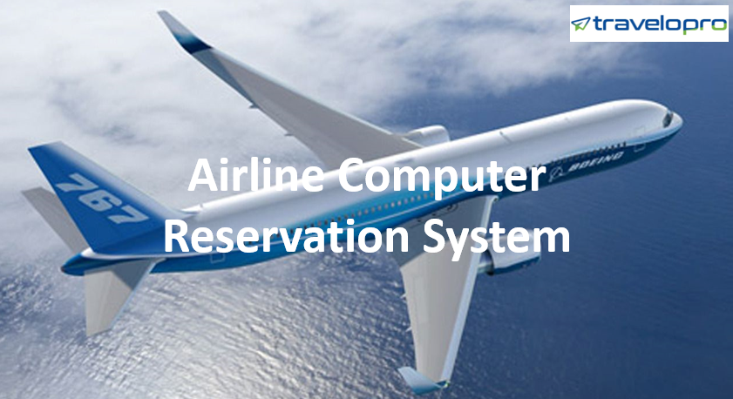
Airline Computer Reservation System
Email id : contact@travelopro.com
Phone No : 98455 66441

Slide 2
What Is Airline Computer Reservation System?
The computerized reservation system, also known as the central reservation system, is the backbone of the travel agent's business. These systems enable the agent to reserve airline tickets, hotel rooms, and rental cars.
Airline Computerized reservation systems are used for inventory management and allow direct access to check availability, make reservations, and print tickets. Moreover, it has become efficient for airlines as they can monitor the behaviour of individual agents. It further helps in designing commissions.
CRSs today offer expanded functionality, from sending confirmation emails, processing payments, and generating KPI reports to driving direct bookings with dynamic pricing and gathering precious customer preference data.

Slide 3
How Does Airline Computer Reservation System Work?
A computerized reservation system is operated by the initial vendor, usually an airline. Although a GDS only displays the vendor’s inventory, every actual purchase is made through the vendor’s computerized reservation system.
While CRS was primarily operated by airlines to deliver data about airlines, travel agencies, hotel chains, and airlines now use the Global Distribution System. GDS not only provides information about travel inventory but also enables making reservations.
At its core, an airline or central reservation system serves as a database for flight schedules, available seats, fares and rules for each booking class, and passenger profiles.

Slide 4
Apart from storing flight-related data, its leading functions include:
Managing reservation requests and cancellations;
Showing flight schedules, available seats, and prices in response to requests from passengers or intermediates (travel agents, call centers, general distribution systems, or GDSs, online travel agencies, or OTAs);
Generating passenger name records (PNRs)—personal codes containing data on travel dates and itinerary, ticket details, baggage, and the passenger’s name and contacts; and
ticketing—issuing tickets (either paper or electronic) and storing ticket records.
To execute its tasks, the CRS is integrated with a flight booking engine and interfaces with passenger touchpoints such as the airline’s website, GDSs, OTAs, and third-party booking platforms.

Slide 5
How Airline Computer Reservation System Is Helping Tour and Travel Companies Grow?
In the fast-paced world of travel and tourism, managing reservations efficiently and effectively is significant for the success of travel agencies. One tool that has revolutionized the industry is the Central Reservation System (CRS).
The worldwide companies that offer global distribution systems are Amadeus, Galileo, Sabre, and Worldspan. They are owned and operated as joint ventures by leading airlines, car rental companies, and hotel groups, also called automated reservation systems (ARS) or computerized reservation systems (CRS).
A computerized reservation system, also called an airline central reservation system (CRS), is used to store flight-related data such as schedules, fares, and passenger name records (PNRs) and distribute information related to air travel to customers and agents.

Slide 6
The airline computerized reservation system (CRS) is one of the most frequently used tools in travel and tourism. The Airline Computer Reservation System is a global distribution system used to book and sell tickets for various airlines.
The airline's computerized reservation system is used to maintain the flight's information and related inventories and rates and manage the reservation system. Airline CRS involves both B2B and B2C interfaces for users to book flights.
A modern, robust, and scalable reservation architecture provides a stable platform for airlines of all sizes and has industry-standard interfaces for all external reservation systems, including GDSs and other airline CRS systems.
The main purpose of CRS was to create a one-stop service shop and eliminate physical and geographical distances between mediators and consumers. With universal coverage, these distribution systems provide data for airlines, hotels, car rental companies, travel agencies, corporations, and more.

Slide 7
The CRS is the system that enables an airline to sell its inventory (seats). It comprises information on schedules and fares as well as a database of reservations (or passenger name records) and of issued tickets.
CRSs are designed and developed to eliminate geographical barriers between air carriers and their customers. These distribution systems perform their functions by connecting with airlines' passenger processing systems and interacting with passenger contact points such as the airline's website, travel agencies, and other third-party booking platforms.
CRS serves the customers of a particular travel provider directly. It enables bookings, guarantees access to pricing information, and now handles bookings through the supplier’s channels, such as websites or call centres.

Slide 8
The majority of airlines have outsourced their central reservation systems (CRSs) to global distribution system (GDS) companies. These GDS companies also facilitate access for customers via internet gateways. For several years, GDS dominated the airline industry.
The travel agents or experts may book or cancel the bookings or tickets online by using the central reservation system, the global distribution system, etc. The CRS enables users to search for flight routes, schedule seat availability, and other relevant information as per their choice. It is not only helpful to the customer but also for the administrators or managers to modify or make changes to existing flights or to start new airlines for new routes, etc.

Slide 9
What Makes Travelopro the Leading Airline Computer Reservation System Provider?
Travelopro is the leading airline computer reservation system provider and have developed technology that facilitates airline merchandise rates and inventory to enhance the conversion rate. Implementing an airline computer reservation system from Travelopro can help businesses enhance efficiencies, maximize revenue, and provide superior customer service.
Our Airlines CRS connects and empowers you to sell your inventory through all B2B and B2C sales channels, including online travel agencies (OTAs). With our airline CRS, you can boost customer engagement, distribution, and brand identity.

Slide 10
We provide an end-to-end service, including the necessary inquiry, strategizing, generating the model, development, integration, quality assurance, and maintenance. We have successfully progressed with enterprise solutions such as ERP, CRM, enterprise mobile application development, enterprise content management, and others.
We design, develop, host, and deliver automation systems to the airline and travel industries, including the latest state-of-the-art airline reservation systems, which provide modern, flexible reservations and inventory management solutions for airlines, including call centers, travel agencies, and internet ticket sales and bookings.
Travelopro is a travel portal development company that develops an airline computer reservation system with GDS system (Amadeus, Galileo, and Sabre) integration, consolidators, XML, and API integration software that includes B2B, B2C, B2B2B, B2B2C, B2E, corporate, super distributor modules, and much more.

Slide 11
With Travelopro CRS, you can optimize customer engagement, distribution, and brand experience. A piece of single, comprehensive information permits a real-time view of your whole business. A CRS will help you effectively manage and keep track of the bookings and reservations created by customers.
It also supports B2C (end-user module), B2B (agent module), B2B2B (sub-agents), and while-labeling products from other OTAs. At the backend, it connects to various suppliers for inventories of flights, hotels, cars, transfers, buses, vacations, and events.
The basic goal of CRS System software was to create a one-stop service shop and eliminate physical and geographical barriers between mediators and consumers. These distribution systems, which have global coverage, give information to airlines, hotels, car rental companies, travel agencies, corporations, and others.

Slide 12
Our cloud platform integrates your CRS with the leading online travel agencies (OTAs) to increase your reach and lower your cost of distribution. With Travelopro, inventory and rate updates to and from your CRS are automatic and real-time, eliminating manual work and lowering your cost of acquisition.
We operate with over 40 top travel aggregators, global distribution systems, channel managers, and DMCs. With a clear focus on technology, agile methodology, and innovation, we ensure quality deliverables and a speedy turnaround to develop and deliver scalable travel portals and booking engines.
As a travel technology expert, we have developed a central reservation system that can be connected to other travel APIs. All the data storage, retrieval, and other transactions can be easily managed with CRS.

Slide 13
A few important features include Instant Create Reservation, Inventories, Connectivity to GDS, being fully flexible and scalable for growing businesses, rate architecture, reservation information, graphical information, and a reporting module.
Through constant innovation, we are shaping the future of travel technology by giving travelers more choice and simplicity. We take pride in being able to connect you to all the leading CRS systems.
Utilizing our Airline CRS as a leading system removes multiple silos of content, rate, availability, restrictions, and reservation data, allowing easy access to a single source of data and valuable dashboard, ad-hoc, and email/excel reporting.

Slide 14
We are concentrating on creating the best travel CRS system that can support both B2B and B2C organizations. We establish the best internet-based Meta Search travel CRS system that can quickly search for flights, cars, and hotels without any delay.
We have a team of 120+ ARS and EDIFACT developers, and our dedicated airline software team follows the best practices to bring leading products to the airline and aviation industries.
In this way, an Airline Computer Reservation System is key for future growth in order to scale processes, especially as your structure grows. Implementing this type of software provides you the possibility to increase visibility by enabling you to work with a wider range of distributors using only single platform.

Slide 15
What Are the Features of Airline Computer Reservation System (Airline CRS)?
CRS empowers users to remotely book travel services online at any time by interfacing with Global Distribution Systems (GDS) and APIs/XMLs. It also provides recording of all the flight-related data, invoicing, accounting, customer, and quota management.

Slide 16
Features of the Airline Computer Reservation System (CRS):
The strongest tool for the distribution of air travel data through web-based applications
Enabling customers to remotely book travel services online at any time
Interfacing with Global Distribution Systems (GDS) and APIs/XMLs
Recording all the flight-related data, such as passenger name records (PNR) or guest name records (GNR).
Provides invoicing, accounting, customer service, and quota management

Slide 17
The Main Features of CRS System:
Multiple GDS and XML connectivity
Computer reservation system integrates
Global distribution system GDS - Amadeus, Galileo, Sabre & Travelport
Flight Consolidators - Arzoo, Mystifly, TBO, Travelfusion, Yatra, MakeMyTrip, Riya travels
Hotel XML / API - Expedia, GTA Travel, HotelBeds, Tourico, HotelsPro, DOTW, Travco, Kuoni, Miki, Jac Travels, Restel, Bonotel
Bus API – Ticketgoose, Abhibus, Travelyaari, Red bus
Car API- CarTrawler, A2B
Transfers API - GTA & Hotelbeds, Cruise API - MSC, Princess and Carnival.

Slide 18
What Are Some of the Basic Functions of Computer Reservation System in the Travel Industry?
Some of the basic functions in a CRS:
Displays travel services with prices and images
Inventory and reservation management
User friendly reservation system
Online payment gateway integration
Customer data management
Email notifications
Booking cancellation and refund management

Slide 19
Wrapping Up:
In summary, an Airline Computer Reservation System is pivotal for travel and airline companies, efficiently managing airline inventory, rates, and reservations, leading to revenue optimization and improved operational efficiency.
By offering streamlined operations, enhanced user experiences, efficient inventory management, and revenue maximization opportunities, CRS empowers executives to stay ahead in the highly competitive travel industry.
We believe that an airline central reservation system should not be a hurdle to your business in any way. We guarantee you peace of mind because our XML flight booking system is highly secure.

Slide 20
CONTACT US: For more details, please visit our website:
https://www.travelopro.com/airline-computer-reservation-system.php
Email id : contact@travelopro.com
Phone No : 98455 66441

